Slide 1
Abilities at Work
A brief look at neurodiversity in the workplace
Kelly M. Caldwell, SHRM-SCP, AWI-CH, IPMA-CP
Partner, Visions Human Resource Services, LLC | President, Mid-Hudson HR Association
Notes:
As prepared for the 2023 Think Jobs Roundtable, FDR Site, Hyde Park
November 8, 2023
Source info: LinkedIn Learning
Nano Tips for Working Inclusively with Neurodivergent Employees with Ellie Middleton
Hiring and Supporting Neurodiversity in the Workplace by Tiffany Jameson

Slide 2
Neurodiversity
Neurodiversity is an umbrella term for autism, ADHD, dyslexia, dysgraphia, and other learning differences
Autism: a neurological and developmental disorder that affects how people interact with others, communicate, learn, and behave
ADHD: a chronic condition including attention difficulty, hyperactivity, and impulsiveness
Dyslexia: a learning disorder that involves difficulty reading due to problems identifying speech sounds and learning how they relate to letters and words
Dysgraphia: a neurological disorder characterized by writing disabilities. Specifically, the disorder causes a person's writing to be distorted or incorrect
We all learn differently; that's a given. But many times, we aren't given the opportunity to advocate for how our learning and communication style influence how we work best.

Slide 3
Neurodiversity
A term representing individuals who cognitively process differently than what society considers the norm
Notes:
Neurodiversity is an umbrella term for autism, ADHD, dyslexia, dysgraphia, and other learning differences
Autism: a neurological and developmental disorder that affects how people interact with others, communicate, learn, and behave
ADHD: a chronic condition including attention difficulty, hyperactivity, and impulsiveness
Dyslexia: a learning disorder that involves difficulty reading due to problems identifying speech sounds and learning how they relate to letters and words
Dysgraphia: a neurological disorder characterized by writing disabilities. Specifically, the disorder causes a person's writing to be distorted or incorrect
We all learn differently; that's a given. But many times, we aren't given the opportunity to advocate for how our learning and communication style influence how we work best.

Slide 4
Challenges for those on the Spectrum of Neurodiversity

Slide 5
Executive Functioning
Executive functioning is a set of mental skills that include working memory, flexible thinking, and self-control.
A person with strong executive functioning can multitask, is extremely organized, and has the ability to plan and prioritize tasks. These individuals work well in project management roles.
We use our executive functioning extensively throughout the day.
When it's not working properly, it can show up as inability to focus, follow directions, handle emotions, and also, plan.

Slide 6
Executive Functioning
Executive functioning is a set of mental skills that include working memory, flexible thinking, and self-control.
Notes:
Executive functioning is a set of mental skills that include working memory, flexible thinking, and self-control.
A person with strong executive functioning can multitask, is extremely organized, and has the ability to plan and prioritize tasks. These individuals work well in project management roles.
We use our executive functioning extensively throughout the day.
When it's not working properly, it can show up as inability to focus, follow directions, handle emotions, and also, plan.

Slide 7
Expressive Language
Difficulties with expressive language, such as thinking on-their-feet, processing questions, or being able to speak at all are common.
Lack of eye contact is common, often sending the wrong message of boredom or inattentiveness.
The use of repetitive or rigid language or even monologue about a topic of interest is common.
Elements of communication, including nonverbal language, can also be a challenge for a neurodivergent to pick up on.
More subtle forms of communication, such as tone, facial expressions, and other non-verbal communication are often missed. This creates a challenge when people are accustomed to certain reciprocal behavior from people they talk with.
You won't always get non-verbal clues and cues, but it doesn't mean the interaction is any less meaningful.

Slide 8
Expressive Language
Difficulties with expressive language, such as thinking on-their-feet, processing questions, or being able to speak at all are common.
Elements of communication, including nonverbal language, can also be a challenge for a neurodivergent employee to pick up on.
Notes:
Difficulties with expressive language, such as thinking on-their-feet, processing questions, or being able to speak at all are common.
Lack of eye contact is common, often sending the wrong message of boredom or inattentiveness.
The use of repetitive or rigid language or even monologue about a topic of interest is common.
Elements of communication, including nonverbal language, can also be a challenge for a neurodivergent to pick up on.
More subtle forms of communication, such as tone, facial expressions, and other non-verbal communication are often missed. This creates a challenge when people are accustomed to certain reciprocal behavior from people they talk with.
You won't always get non-verbal clues and cues, but it doesn't mean the interaction is any less meaningful.

Slide 9
Camouflage / Masking
Social camouflaging or masking is the behavior of trying to act normal, communicate normal and hide neurodivergent traits. I best heard this described like this:
Each morning, you wake up with a full cup of water. That's your resources for the day.
Typically, you lose a little water here and there throughout the day until you're pretty low.
For some, that cup has a bunch of tiny holes in it, and before they can even get started with their day, their resources are being lost.
Their energy switches to keeping water in the cup. Unfortunately, this activity only makes the cup drain quicker.
The cup with holes is a representation of a neurodivergent's use of camouflaging, or also called masking.
Many social camouflage to escape the various stigmas associated with neurodivergent conditions or to escape bullying and ridicule they have experienced in the past.
Think of it as post-traumatic stress and social camouflaging is their coping mechanism.
Camouflaging leads to anxiety and burnout.
The general population doesn't understand these impairments, how they manifest and what they mean for their coworker's ability to perform work. Innocent ignorance of neurodivergent by coworkers is the number one reason an individual will tax their system by social camouflaging
In creating a neurodivergent-friendly environment, their energy translates into productivity and innovation for your organization

Slide 10
Camouflage / Masking
Social camouflaging or masking is the behavior of trying to act normal, communicate normal and hide neurodivergent traits.
Camouflaging leads to anxiety and burnout.
Notes:
Social camouflaging or masking is the behavior of trying to act normal, communicate normal and hide neurodivergent traits. I best heard this described like this:
Each morning, you wake up with a full cup of water. That's your resources for the day.
Typically, you lose a little water here and there throughout the day until you're pretty low.
For some, that cup has a bunch of tiny holes in it, and before they can even get started with their day, their resources are being lost.
Their energy switches to keeping water in the cup. Unfortunately, this activity only makes the cup drain quicker.
The cup with holes is a representation of a neurodivergent's use of camouflaging, or also called masking.
Many social camouflage to escape the various stigmas associated with neurodivergent conditions or to escape bullying and ridicule they have experienced in the past.
Think of it as post-traumatic stress and social camouflaging is their coping mechanism.
Camouflaging leads to anxiety and burnout.
The general population doesn't understand these impairments, how they manifest and what they mean for their coworker's ability to perform work. Innocent ignorance of neurodivergent by coworkers is the number one reason an individual will tax their system by social camouflaging
In creating a neurodivergent-friendly environment, their energy translates into productivity and innovation for your organization

Slide 11
Related Terms
Neurodiversity | A term representing individuals who cognitively process differently than what society considers the norm
Camouflaging | A behavior that involves trying to act or communicate in a way that hides neurodivergent traits; also known as masking
Impression management | When an individual tries to influence how a person perceives them by controlling the social situation
Reasonable accommodation | When an organization is allowed to support the employee but not create a substantial burden
Workplace accommodation | Any change or adjustment made to the actual job, job environment, or processes to allow an individual with a disability to apply for a job, secure a job, or access benefits that are available for other individuals in the workplace

Slide 12
Tips for Working Inclusively with Neurodivergent Employees
Pro tip: these help with all employees, neurotypical and neurodivergent

Slide 13
Inclusive Learning Design
Just like everyone in the workplace, neurodivergent employees have different styles in the way that they learn
Audio learning style
Visual learning style
Kinesthetic learning style
Neurodivergent people can have struggles with auditory processing. This means that when you give us a verbal instruction, it may go in one ear and out the other without being properly processed by the brain. A really quick and easy way to accommodate for this is making sure that any verbal instructions are followed up with the same instructions given in a written format.

Slide 14
Inclusive Learning Design
Notes:
Just like everyone in the workplace, neurodivergent employees have different styles in the way that they learn
Audio learning style
Visual learning style
Kinesthetic learning style
Neurodivergent people can have struggles with auditory processing. This means that when you give us a verbal instruction, it may go in one ear and out the other without being properly processed by the brain. A really quick and easy way to accommodate for this is making sure that any verbal instructions are followed up with the same instructions given in a written format.

Slide 15
Provide Clarity Ahead of Time
Specifically, employees with autism and ADHD can struggle with being caught off guard
To get the best out of your neurodivergent team members, you need to provide as much information as you can ahead of time
Provide agendas ahead of meeting times
Send a message before a call to ask if free and to give the purpose of the call
Have clearly outlined processes and policies in writing
Provide information as it happens, instead of data dumping

Slide 16
Provide Clarity Ahead of Time
Notes:
Specifically, employees with autism and ADHD can struggle with being caught off guard
To get the best out of your neurodivergent team members, you need to provide as much information as you can ahead of time
Provide agendas ahead of meeting times
Send a message before a call to ask if free and to give the purpose of the call
Have clearly outlined processes and policies in writing
Provide information as it happens, instead of data dumping

Slide 17
Give Clear Instructions
Neurodivergent people, specifically autistic people, need instructions to be very clear, concise, and specific
We're not very good at reading between the lines, and we need you to spell out exactly what you want from us.
Give instructions on a what, by when, and why basis.
With extreme clearly state:
what exactly do you need from somebody
when exactly do you need each of those things by, and
why you need each of those things

Slide 18
Give Clear Instructions
Notes:
Neurodivergent people, specifically autistic people, need instructions to be very clear, concise, and specific
We're not very good at reading between the lines, and we need you to spell out exactly what you want from us.
Give instructions on a what, by when, and why basis.
With extreme clearly state:
what exactly do you need from somebody
when exactly do you need each of those things by, and
why you need each of those things

Slide 19
Provide Enough Clarity
Most people get overwhelmed by having too much information all at once, whereas neurodivergent people tend to go the opposite way.
They tend to get overwhelmed by not having enough information to be able to build a full picture
If the information needed to build the whole picture of something is missing, the brain is constantly going to be looking for that information.
Give all the information that they might need (or make it accessible to them should they want to look for it), rather than just drip-feeding information on a need-to-know basis
Generally, make sure that information is available to everyone that needs it and they don't have to ask for it and they don't have to try and fill the gaps in themselves

Slide 20
Provide Enough Clarity
Notes:
Most people get overwhelmed by having too much information all at once, whereas neurodivergent people tend to go the opposite way.
They tend to get overwhelmed by not having enough information to be able to build a full picture
If the information needed to build the whole picture of something is missing, the brain is constantly going to be looking for that information.
Give all the information that they might need (or make it accessible to them should they want to look for it), rather than just drip-feeding information on a need-to-know basis
Generally, make sure that information is available to everyone that needs it and they don't have to ask for it and they don't have to try and fill the gaps in themselves

Slide 21
Say What You Mean
Some neurodivergent people can struggle to read between the lines
Autistic people specifically are very literal thinkers, which means that they may not see a bigger picture
If you hint at something, they may not be able to work that out
Avoid terms that don't really have much meaning
Terms like run-through, touch-base, check-in, and similar workplace lingo don't clearly convey instructions in a in black and white manner
Instead of asking somebody to touch-base on something, tell them that you want to have a discussion to talk through their findings, being specific about what the method (meeting, call, email, etc.) and what is going to happen, hopefully with a simple agenda sent in advance
Communicate clearly and do not assume that others are able to read between the lines in order to work out what you want from them.

Slide 22
Say What You Mean
Notes:
Some neurodivergent people can struggle to read between the lines
Autistic people specifically are very literal thinkers, which means that they may not see a bigger picture
If you hint at something, they may not be able to work that out
Avoid terms that don't really have much meaning
Terms like run-through, touch-base, check-in, and similar workplace lingo don't clearly convey instructions in a in black and white manner
Instead of asking somebody to touch-base on something, tell them that you want to have a discussion to talk through their findings, being specific about what the method (meeting, call, email, etc.) and what is going to happen, hopefully with a simple agenda sent in advance
Communicate clearly and do not assume that others are able to read between the lines in order to work out what you want from them.

Slide 23
Be Precise in Communications
As literal thinkers, neurodivergent people take words as facts, so it’s important to make sure that the words that you're using are representative of the actual importance or the actual meaning behind what you want them to say
Urgency. Do not use the word urgent unless something really is urgent. If you say that something is urgent, some may think that it's a life-or-death matter, leaving everything behind until the thing is completed.
If you actually mean that something needs to be completed by the end of the day, it's much more important for you to use these words, by the end of the day, to save panic and inefficiency
Be precise with what you mean
Be intentionally specific with deadlines, instructions, and just the words that you're using
The words that you say have a real weight when it comes to the importance that neurodivergent people put behind them; make sure that you're being as clear and as precise as you possibly can

Slide 24
Be Precise in Communications
Notes:
As literal thinkers, neurodivergent people take words as facts, so it’s important to make sure that the words that you're using are representative of the actual importance or the actual meaning behind what you want them to say
Urgency. Do not use the word urgent unless something really is urgent. If you say that something is urgent, some may think that it's a life-or-death matter, leaving everything behind until the thing is completed.
If you actually mean that something needs to be completed by the end of the day, it's much more important for you to use these words, by the end of the day, to save panic and inefficiency
Be precise with what you mean
Be intentionally specific with deadlines, instructions, and just the words that you're using
The words that you say have a real weight when it comes to the importance that neurodivergent people put behind them; make sure that you're being as clear and as precise as you possibly can

Slide 25
Avoid Ableist Language
Many ableist terms have made their way into our everyday vocabulary, which means that they're being used within companies and in external marketing
This is something that needs to be avoided as it perpetuates a stigma and creates a hostile work environment to neurodivergent people
Words like mad, mental, insane aren’t appropriate in almost any situation, especially when we're referring to something good that's happened.
We don’t often realize the weight of those words, because they've been used to marginalize neurodivergent and people with mental illnesses in the past.
Instead of using the words mad, insane, or mental, replace those words with wild, exciting, amazing.
Simply put, just make sure that the words that you're using don't have connotations that could offend or traumatize people within the workplace.

Slide 26
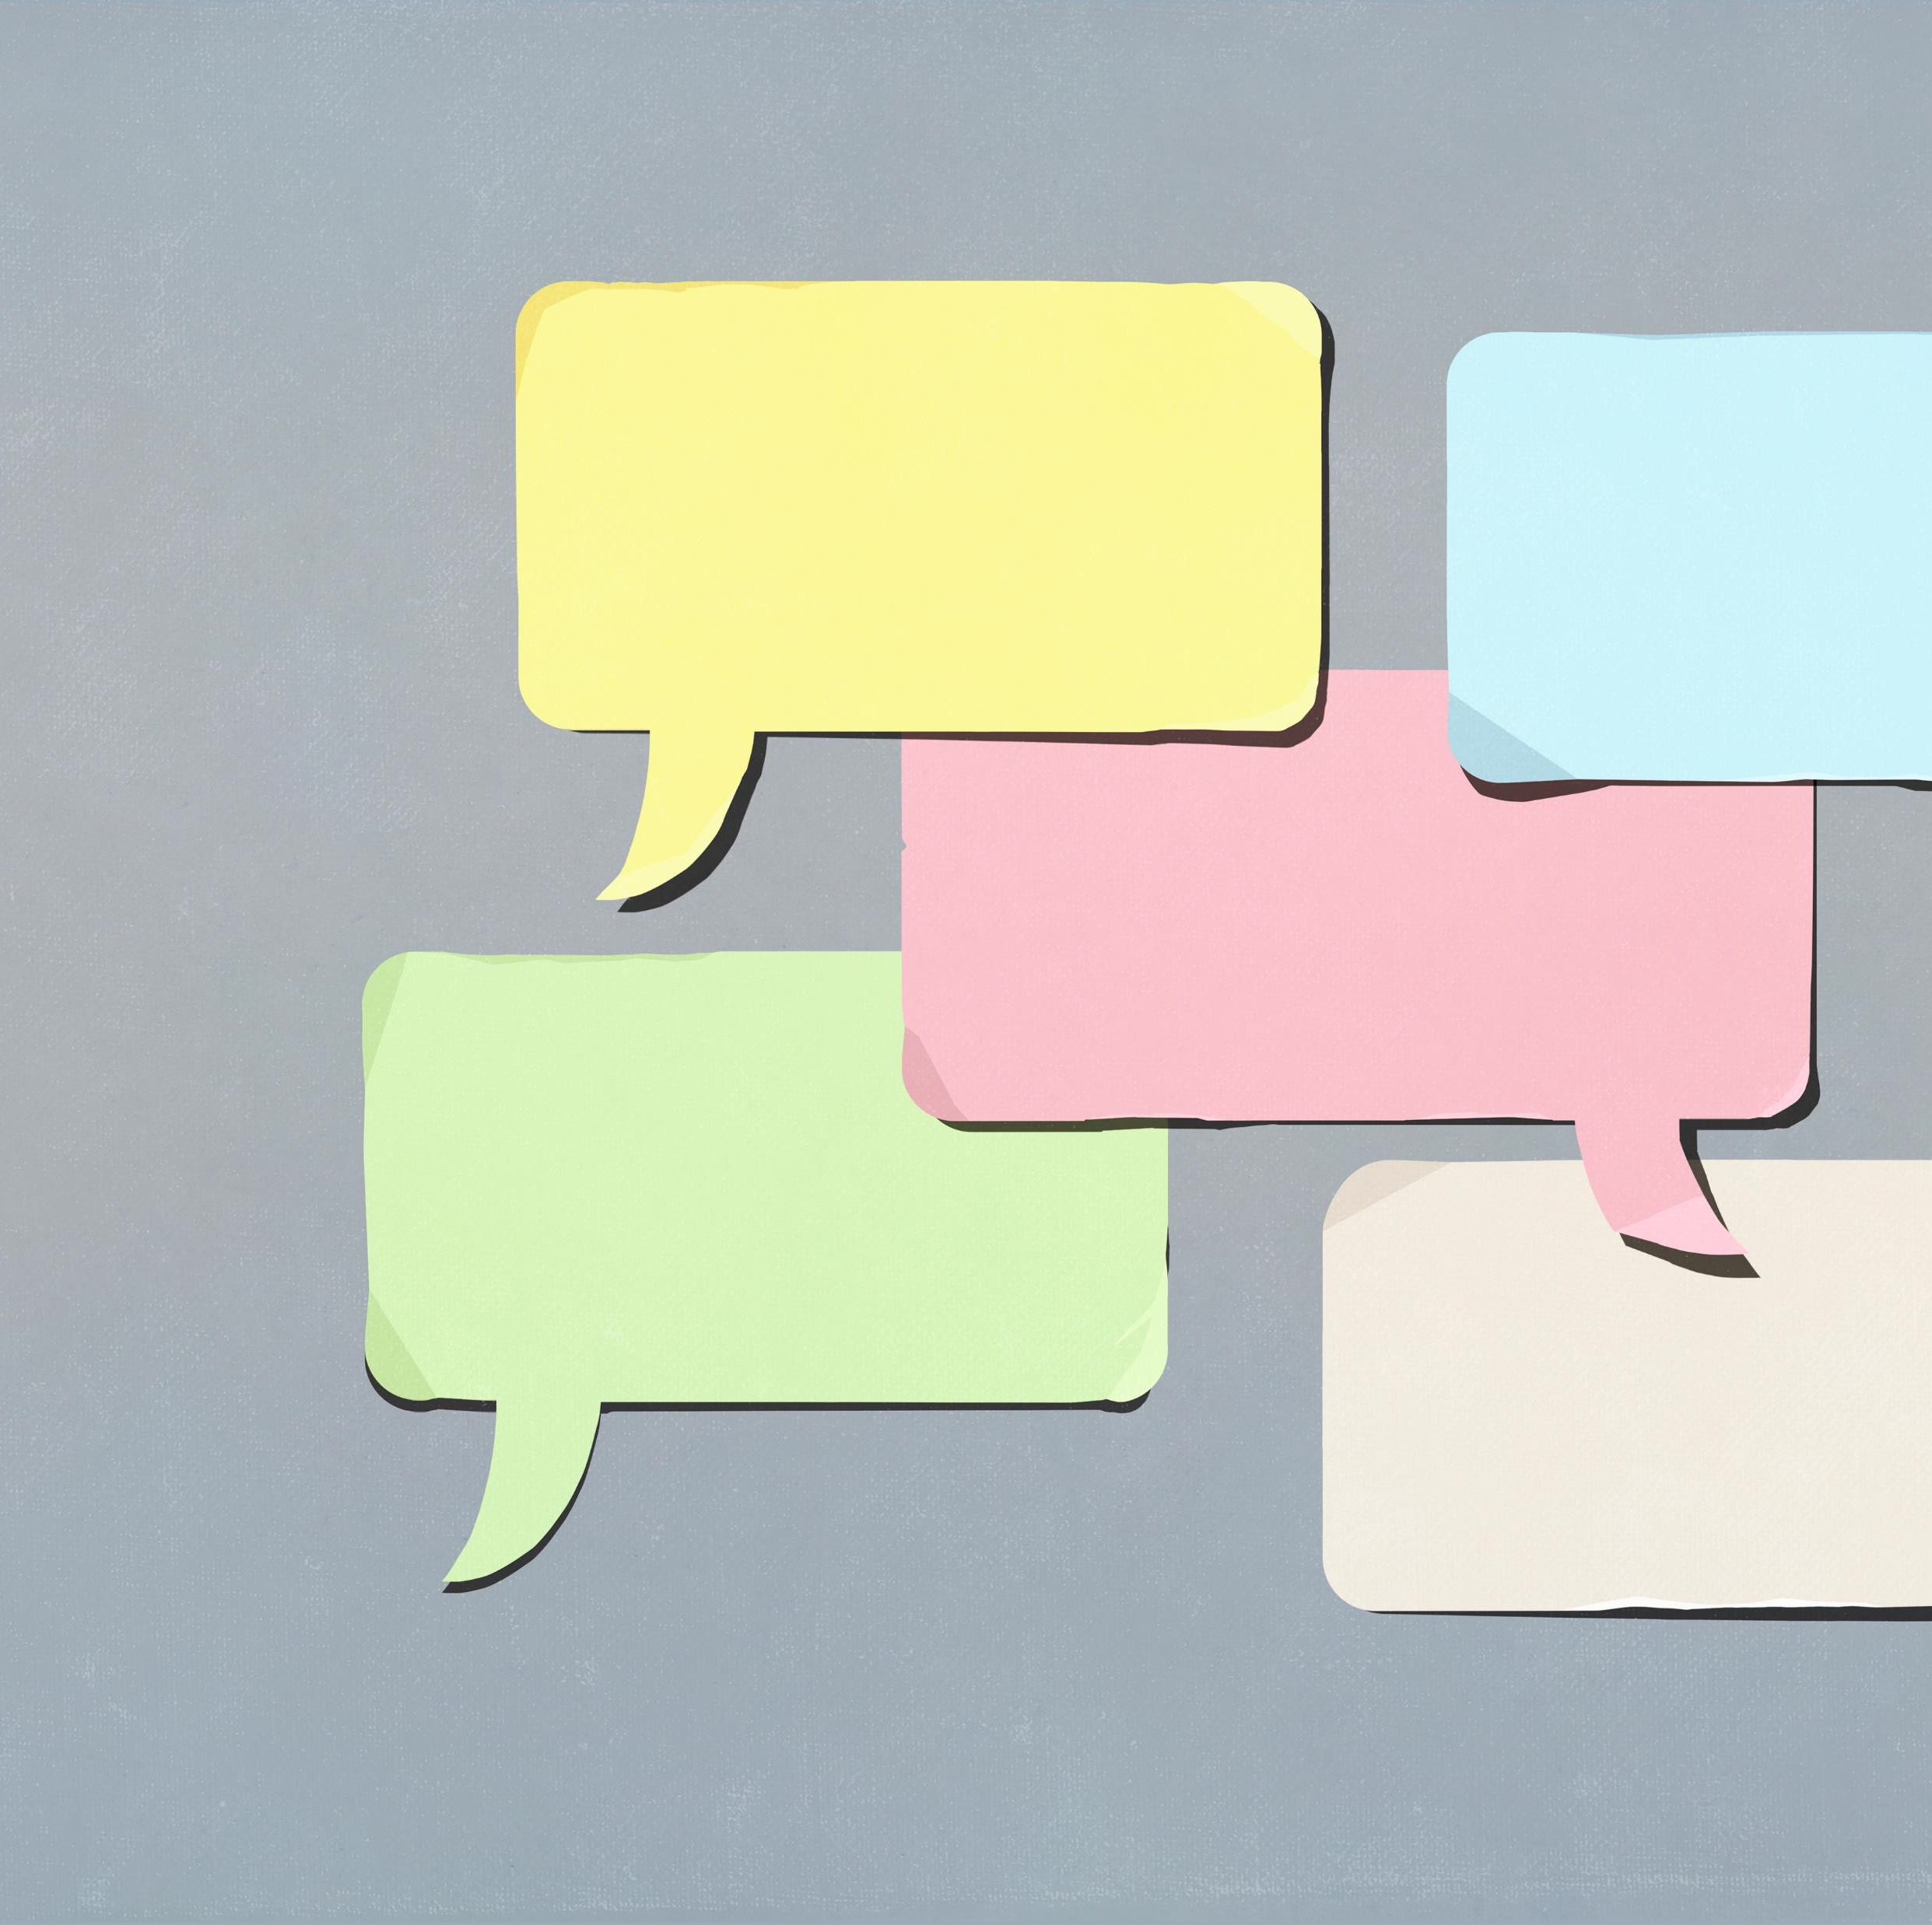
Avoid Ableist Language
Notes:
Many ableist terms have made their way into our everyday vocabulary, which means that they're being used within companies and in external marketing
This is something that needs to be avoided as it perpetuates a stigma and creates a hostile work environment to neurodivergent people
Words like mad, mental, insane aren’t appropriate in almost any situation, especially when we're referring to something good that's happened.
We don’t often realize the weight of those words, because they've been used to marginalize neurodivergent and people with mental illnesses in the past.
Instead of using the words mad, insane, or mental, replace those words with wild, exciting, amazing.
Simply put, just make sure that the words that you're using don't have connotations that could offend or traumatize people within the workplace.

Slide 27
Accept Alternative Work Styles
100% doesn't look the same for everybody.
Many have learned that they produce their best work in sprints, not marathons.
Some people cannot sit behind a desk for 40 hours. Instead, they can work in short bursts; it may look like two hours on and then one hour of rest to recover from that.
Working for less time than everybody else in the team doesn't mean that this employee will achieve anything less than anyone else in the team. It just means that they work in short intense bursts and then take breaks while still getting as much done in that routine as other people might get done, being sat behind a desk for the full work week.
Remember that everybody has different styles.
Some people might be morning people, some people might be evening people. Some people might work over long periods of time and some people might work in short bursts. But this doesn't mean that they're doing any less or that they're working any less hard.

Slide 28
Accept Alternative Work Styles
Notes:
100% doesn't look the same for everybody.
Many have learned that they produce their best work in sprints, not marathons.
Some people cannot sit behind a desk for 40 hours. Instead, they can work in short bursts; it may look like two hours on and then one hour of rest to recover from that.
Working for less time than everybody else in the team doesn't mean that this employee will achieve anything less than anyone else in the team. It just means that they work in short intense bursts and then take breaks while still getting as much done in that routine as other people might get done, being sat behind a desk for the full work week.
Remember that everybody has different styles.
Some people might be morning people, some people might be evening people. Some people might work over long periods of time and some people might work in short bursts. But this doesn't mean that they're doing any less or that they're working any less hard.

Slide 29
Create Sensory-Friendly Environments
Workplaces can be a sensory nightmare for neurodivergent people
Different sounds, smells, and things to keep track of. There's bright lights, it's quite a busy environment, and all of this added together can make it quite overwhelming
Neurodivergent people generally tend to experience their senses in more of an intense and extreme way than neurotypical people
Ask people to take calls in a certain space, rather than taking them in the main office, so that the main office stays quiet
Ask people to listen to music or calls through headphones, rather than having the radio playing out loud in the office
Ask people to go to a certain place to eat their lunch, rather than eating at their desk, so that there's not different smells floating around the office
Allow people to wear clothes that they feel comfortable in, so that they're not overwhelmed by the scratchy feeling of an uncomfortable suit

Slide 30
Create Sensory-Friendly Environments
Notes:
Workplaces can be a sensory nightmare for neurodivergent people
Different sounds, smells, and things to keep track of. There's bright lights, it's quite a busy environment, and all of this added together can make it quite overwhelming
Neurodivergent people generally tend to experience their senses in more of an intense and extreme way than neurotypical people
Ask people to take calls in a certain space, rather than taking them in the main office, so that the main office stays quiet
Ask people to listen to music or calls through headphones, rather than having the radio playing out loud in the office
Ask people to go to a certain place to eat their lunch, rather than eating at their desk, so that there's not different smells floating around the office
Allow people to wear clothes that they feel comfortable in, so that they're not overwhelmed by the scratchy feeling of an uncomfortable suit

Slide 31
Recruitment and Accommodation

Slide 32
Sourcing Talent
Neurodiversity is not visible. You might have already missed hiring great candidates because of a failure in your traditional interview processes. To increase your workforce diversity, you must also increase where you look for candidates.
30-85% of able, neurodivergent people are unemployed.
The traditional means of applying, interviewing and keeping a job are not working.
You should know that local and federal governments have many programs that can help facilitate employment experiences for neurodivergent people. These programs are vocational rehabilitation focused and support preparing the individual for employment, facilitates opportunities, and additionally, supports the candidates through the hiring process. They could provide onsite support for a period of time after employment begins. Most of these programs require an individual to qualify for the use of their services.
Second, parent and adult support groups in your local community can be a wealth of talent. Support groups focus on a specific element of neurodiversity. They provide mentorship, workshop, and speakers to help individuals grow and find community. A simple internet search will provide you with a number of different resources in your area to reach out for candidates.
Third, connecting with university and junior college career offices can align you with fantastic talent. The word will get out that your organization is open to hiring all talent and this will make more resumes and more talent come your way.
Then, there are employment agencies. Some agencies are intentional about gathering your divergent talent and contracting with organizations. The recruiter at these agencies might support the applicant during the application, interview and assimilating process. If you want to be inclusive, but you don't have the resources to increase your head count, you could outsource a business need. For example, a software company might outsource its quality assurance or accessibility testing.
Now, if you're a smaller organization, a best practice is to start a progressive hiring program slowly and consistently add neurodivergent employees to the company culture. We know from research that creating an inclusive workplace with neurodivergent employees increases retention and enhances the overall culture of the entire organization. Once the right practices are in place, the whole organization benefits. This might be the beginning of your company's inclusion journey. As you create an inclusive workplace, you'll watch your organization thrive as a result.

Slide 33
Sourcing Talent
Government / community programs
Parent and adult support groups
Higher education institutions
Specialized education institutions
Employment agencies
The key is to make sure that your workplace is inclusive and that it invites, celebrates, and supports neurodiversity (in honesty, it must highly value diversity as a whole)
Notes:
Neurodiversity is not visible. You might have already missed hiring great candidates because of a failure in your traditional interview processes. To increase your workforce diversity, you must also increase where you look for candidates.
30-85% of able, neurodivergent people are unemployed.
The traditional means of applying, interviewing and keeping a job are not working.
Local and federal governments have programs that can help facilitate employment experiences for neurodivergent people. These programs are vocational rehabilitation focused and support preparing the individual for employment, facilitates opportunities, and additionally, supports the candidates through the hiring process. They could provide onsite support for a period of time after employment begins. Most of these programs require an individual to qualify for the use of their services.
Second, parent and adult support groups in your local community can be a wealth of talent. Support groups focus on a specific element of neurodiversity. They provide mentorship, workshop, and speakers to help individuals grow and find community. A simple internet search will provide you with a number of different resources in your area to reach out for candidates.
Third, connecting with university and junior college career offices can align you with fantastic talent. The word will get out that your organization is open to hiring all talent and this will make more resumes and more talent come your way.
Then, there are employment agencies. Some agencies are intentional about gathering your divergent talent and contracting with organizations. The recruiter at these agencies might support the applicant during the application, interview and assimilating process. If you want to be inclusive, but you don't have the resources to increase your head count, you could outsource a business need. For example, a software company might outsource its quality assurance or accessibility testing.
Now, if you're a smaller organization, a best practice is to start a progressive hiring program slowly and consistently add neurodivergent employees to the company culture. We know from research that creating an inclusive workplace with neurodivergent employees increases retention and enhances the overall culture of the entire organization. Once the right practices are in place, the whole organization benefits. This might be the beginning of your company's inclusion journey. As you create an inclusive workplace, you'll watch your organization thrive as a result.

Slide 34
Revise the Interview Process
A traditional interview approach is behavioral-based. It asks how the candidate handled something in the past. And this interview approach is often the nemesis for employment for neurodivergent. Why?
First, they require an abstract type of thinking on your feet that requires quick auditory processing and working memory. More abstract questions require more energy to figure out what the real question is.
Second, gaps in employment or lack of past experience for this group is common, often eliminating them from having experiences to share.
Then thirdly, there is impression management. Usually, the neurodivergent knows they should be putting on a positive front, but feeling like they have to present themselves in a certain way to appear normal just adds another layer of anxiety to manage.
What should an interview look like? If you must include a traditional interview, here's what your team can do to allow interviewees to represent themselves to their fullest potential.
First, provide interview questions at least 24 hours before the interview. This will allow the candidate an opportunity to formulate responses without the processing pressure.
Ask all candidates if they need assistance. They might need help accessing greater detail around the interview, such as location, process, or agenda.
Pause after asking a question. Provide more time for the individual to answer a question. Do not assume a lack of a quick response is a lack of knowledge.
Move from the traditional interview approach to an inclusive interview approach.
Different, more applied skills and knowledge techniques to assess if a candidate can accomplish or has the aptitude to complete the essential job functions
Work-based interviews are a more inclusive approach. They remove the impression management and all the questions about non-job-related subjects.
To plan an inclusive work-based interview, the first step is to go back to the job analysis and ensure that all job descriptions are reflective of the tasks required. By revising your job descriptions and interview process to remove ambiguity, neurodivergent talent will have the opportunity to demonstrate their skills and abilities in a more relaxed and less formal environment. Look for blanket statements like good communicators that have little meaning. Instead, use precise statements like ability to write multi-step directions to communicate the process with team members, or provide regular updates on status on projects using Slack or Teams. You can then design work-based interviews to assess those specific skills and create a more inclusive interview process for all. For example, if the job requires the use of a particular software or hardware, then part of the interview would enable the interviewee to show these skills.
If the job requires the motor skills like threading needles, then threading needles during the interview would demonstrate the ability to do the essential job.
If providing the analytical overview of content is required, set up a sample situation and see how the individual goes about breaking down the process.
These are just some of the ways you can modify your interviews to make sure you're not missing great talent. Get with your team members and start the conversation about how you can rethink your interview process to make it more inclusive.

Slide 35
Revise the Interview Process
Switch from traditional, behavioral-based interviewing to an inclusive, work-based interview approach
Notes:
What should an interview look like? If you must include a traditional interview, here's what your team can do to allow interviewees to represent themselves to their fullest potential.
First, provide interview questions at least 24 hours before the interview. This will allow the candidate an opportunity to formulate responses without the processing pressure.
Ask all candidates if they need assistance. They might need help accessing greater detail around the interview, such as location, process, or agenda.
Pause after asking a question. Provide more time for the individual to answer a question. Do not assume a lack of a quick response is a lack of knowledge.
Move from the traditional interview approach to an inclusive interview approach.
Different, more applied skills and knowledge techniques to assess if a candidate can accomplish or has the aptitude to complete the essential job functions
Work-based interviews are a more inclusive approach. They remove the impression management and all the questions about non-job-related subjects.

Slide 36
Accommodating Candidates and Employees
Workplace accommodation: any change or adjustment to the actual job, the job environment, or the way of doing things to allow an individual with a disability to apply for a job, secure a job or acquire access to benefits available to other individuals in the workplace.
An employee may have chronic pain - allow flexible start and end times as long as the channels of communication are kept open.
Some individuals skip permission to record meetings using their phones so they can play them back later time to ensure they don't miss anything. This allows them to keep up with the pace of the meeting and take notes later.
These are all examples of reasonable accommodations and none of these costs a thing.
Reasonable accommodations allow an individual with a disadvantage to have tools that provide access to the same opportunities as all other employees.
A reasonable accommodation is one allows the organization to support the employee but not create a substantial burden.
Accommodations should be put in place to complete the essential job functions.
If an essential job function can not be completed with reasonable accommodations, the individual may not be a good fit for the job.
Resources such as askjan.org and earn.org, provide guidance on accommodations for different scenarios.
Research into the cost of accommodations, often a concern of the organization, has found that the average accommodation costs less than $500.
But the best practice is to provide the opportunity for reasonable accommodations to all candidates and employees. I'd like to share a couple of common accommodations you want to be aware of when you're creating an inclusive environment. The first type of accommodation falls under assistive technology. This can be as straightforward as a wheelchair or hearing aids, or more unique like computer software and hardware to help people with mobility and sensory impairments function in their workplace. There's an increased focus by commonly used software vendors on accessible applications, providing more opportunities for out of the box for individuals that work differently. The second type of accommodation can come in the form of a job or career coach. This individual helps the worker facilitate their day by educating the workplace on the individual's challenges. They suggest modifications and work to help the task get accomplished in their unique approach. Or guiding the individual through daily challenges that they may have in the workplace. The third type of accommodation is a flexible work schedule. By providing a flexible work schedule, individuals can plan their work tasks during times they're most productive. Take breaks as needed and be more energized when they're working. For some narrow divergent normal sleep patterns may be difficult and having a flexible start time can allow them to come to work rested and ready to go. Others without transportation can use a flexible work schedule to plan their hours around available transportation. Accommodation does not need to be a scary word for the human resource manager. We all need our work modified in some ways. And if an individual needs help to do this, reasonable accommodations will be helpful to set the worker up to do their best work and have a long productive tenure at your company.

Slide 37
Accommodating Candidates and Employees
Workplace accommodation: any change or adjustment to the actual job, the job environment, or the way of doing things to allow an individual with a disability to apply for a job, secure a job or acquire access to benefits available to other individuals in the workplace.
Often implemented at no to little cost (< $500)
Notes:
Workplace accommodation: any change or adjustment to the actual job, the job environment, or the way of doing things to allow an individual with a disability to apply for a job, secure a job or acquire access to benefits available to other individuals in the workplace.
Reasonable accommodations allow an individual with a disadvantage to have tools that provide access to the same opportunities as all other employees.
A reasonable accommodation is one allows the organization to support the employee but not create a substantial burden.
Accommodations should be put in place to complete the essential job functions.
If an essential job function can not be completed with reasonable accommodations, the individual may not be a good fit for the job.

Slide 38
One Parting Gift…

Slide 39
Employing Abilities at Work Certificate Program
This program will empower you to:
Understand the barriers to employment experienced by individuals with disabilities.
Articulate the business case for building a workforce that is equitable and inclusive of individuals with disabilities.
Create organizational strategies to recruit, hire, retain, and develop this talent pool.
Educate your stakeholders to reduce barriers to employment faced by individuals with disabilities.

Slide 40
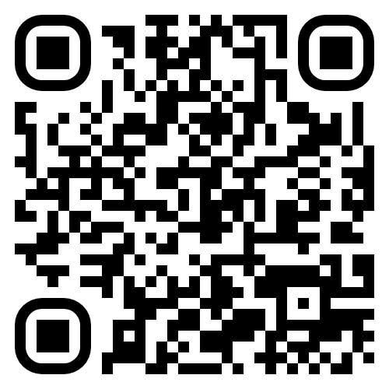
Employing Abilities at Work Certificate Program
Price: FREE
employingabilities.org/certificate

