Slide 1


2020 Ulster BOCES Virtual Employability Conference

Slide 2
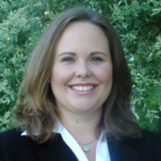


Kelly M. Caldwell, SHRM-SCP
Director of Human Resources | OELS PEO
kellymcaldwell | kcaldwell@oelspeo.com | 315-804-6797
Outside of my professional career, I am a family member, community volunteer, and friend.
At work, I am a Human Resources management professional who builds strong, compliant workplace cultures through a combination of exceptional interpersonal communication skills, employment and labor law knowledge, and employee relations experience, working seamlessly with all levels of employees, executives and board members.
I also serve on the Mid-Hudson Human Resource Association Board as President-Elect and the Junior League of Kingston as the Nominating Placement & Membership Chairperson.

Slide 3

This presentation will be interactive. Here’s how to participate:

Slide 4
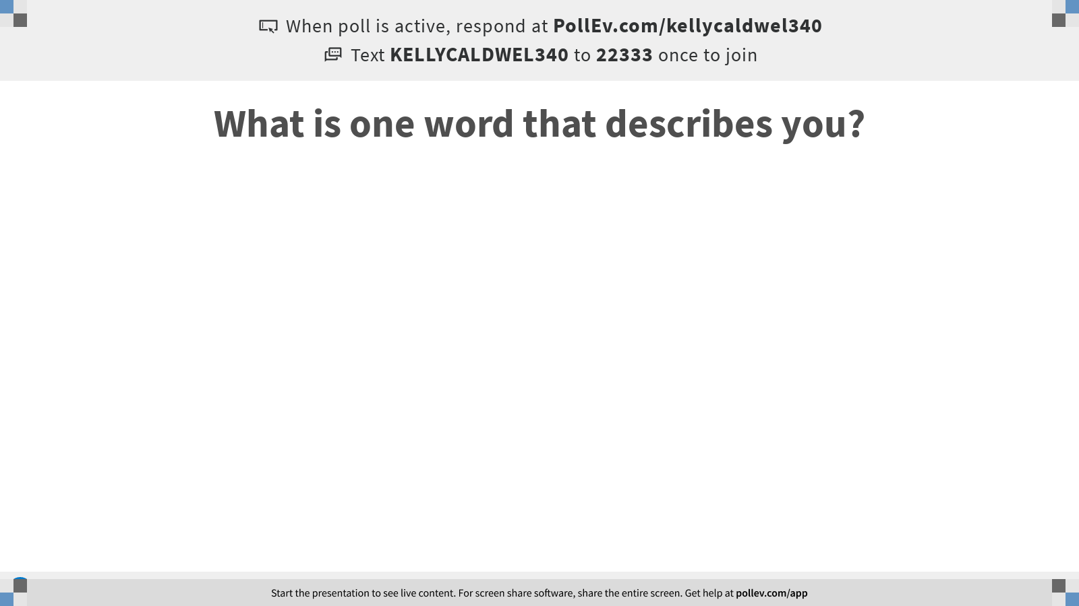
Notes:
Poll Title: What is one word that describes you?
https://www.polleverywhere.com/free_text_polls/ZEuO9VI2rT8upVooYaVIr

Slide 5
What makes someone employable?
What are the skills that employers are most often looking for?

Slide 6
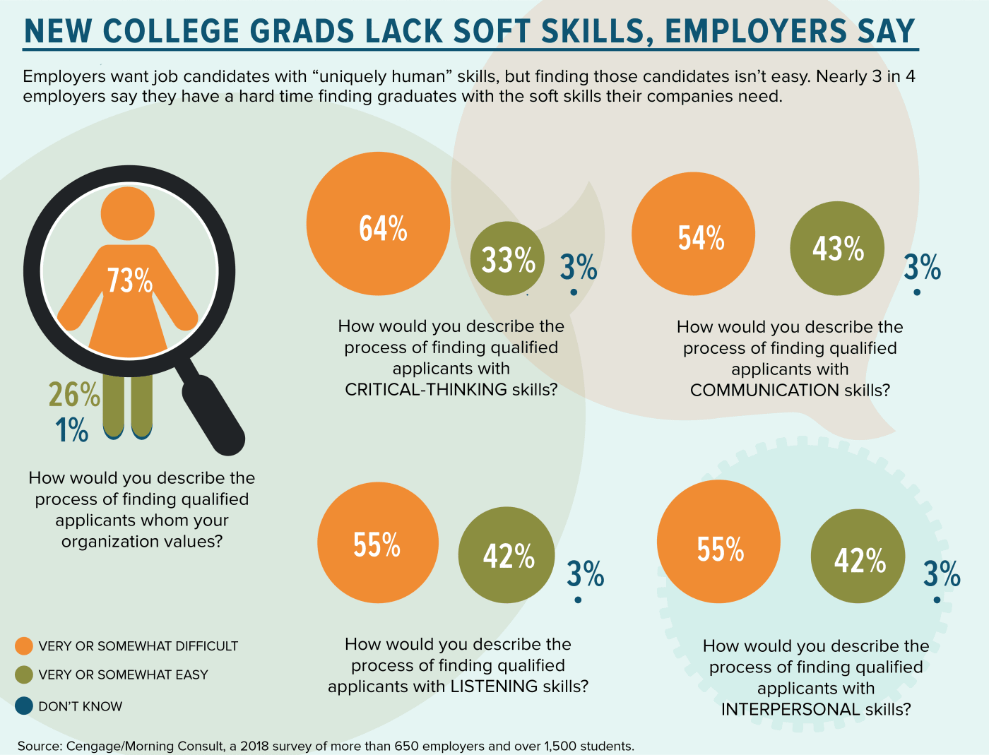
According to the Society for Human Resources Management, employers are looking for more than technical skills or experience; they are looking for soft skills.¹
Wikipedia defines soft skills as a “combination of people skills, social skills, communication skills, character or personality traits, attitudes, career attributes, social intelligence and emotional intelligence quotients, among others, that enable people to navigate their environment, work well with others, perform well, and achieve their goals with complementing hard skills.”²

Slide 7
Commonly sought-after soft skills include:
Reliability
Notes:
Reliability is essential to employee performance. Reliability consists of the extent to which an individual or other entity may be counted on to do what is expected of him. For example, a reliable employee is one who shows up for work on time and is prepared to complete his work in a timely manner.
https://smallbusiness.chron.com/form-reliability-affects-employee-performance-17633.html#:~:text=Reliability%20is%20essential%20to%20employee,work%20in%20a%20timely%20manner.

Slide 8
Commonly sought-after soft skills include:
Reliability
Punctuality
Notes:
Punctuality is a wonderful trait of a person, one to be admired and respected. Punctuality displays a person's respect for people and time. Many people work from home these days, to them punctuality means being available online during office hours, logging in into meetings punctually, and meeting project deadlines.
https://www.linkedin.com/pulse/benefits-punctuality-work-yeukai-kajidori#:~:text=Punctuality%20is%20a%20wonderful%20trait,respect%20for%20people%20and%20time.&text=Many%20people%20work%20from%20home,punctually%2C%20and%20meeting%20project%20deadlines.

Slide 9
Commonly sought-after soft skills include:
Reliability
Punctuality
Communication
Notes:
Workplace communication is the process of exchanging information and ideas, both verbal and non-verbal between one person/group and another person/group within an organization. Workplace communication is tremendously important to organizations because it increases productivity and efficiency.
https://en.wikipedia.org/wiki/Workplace_communication

Slide 10
Commonly sought-after soft skills include:
Reliability
Punctuality
Communication
Relationship Management
Notes:
Employee relationship management is a process that companies use to effectively manage all interactions with employees, ultimately to achieve the goals of the organization.
https://smallbusiness.chron.com/employee-relationship-management-709.html#:~:text=Employee%20relationship%20management%20is%20a,the%20goals%20of%20the%20organization.

Slide 11
Commonly sought-after soft skills include:
Reliability
Punctuality
Communication
Relationship Management
Enthusiasm
Notes:
Overall, an employee with enthusiasm comes across as someone who wants to be at work and who is willing to do what it takes to get the job done. The activities in this section seek to teach participants about the importance of enthusiasm and a positive attitude in the workplace.
https://www.dol.gov/odep/topics/youth/softskills/Enthusiasm.pdf

Slide 12
Commonly sought-after soft skills include:
Reliability
Punctuality
Communication
Relationship Management
Enthusiasm
Initiative
Notes:
When you show initiative, you do things without being told; you find out what you need to know; you keep going when things get tough; and you spot and take advantage of opportunities that others pass by. You act, instead of reacting, at work.
https://www.mindtools.com/pages/article/initiative.htm#:~:text=Defining%20Initiative&text=When%20you%20show%20initiative%2C%20you,instead%20of%20reacting%2C%20at%20work.

Slide 13
Commonly sought-after soft skills include:
Reliability
Punctuality
Communication
Relationship Management
Enthusiasm
Initiative
Flexibility
Notes:
Flexibility on the job includes the willingness and ability to respond to changing circumstances and expectations readily. By definition, the term "flexibility" means the ability to bend or adapt to changing forces.
https://www.thebalancecareers.com/workplace-flexibility-definition-with-examples-2059699#:~:text=Flexibility%20is%20an%20important%20trait,work%20is%20worth%20a%20lot.

Slide 14
Commonly sought-after soft skills include:
Reliability
Punctuality
Communication
Relationship Management
Enthusiasm
Initiative
Flexibility
Adaptability
Notes:
Adaptability in the workplace﻿ means being able to change in order to become successful. Adaptability is a soft skill that employers seek when hiring candidates. Employees in a leadership role often have to manage unusual circumstances where there are no explicit instructions.
https://www.thebalancecareers.com/important-adaptability-skills-4768260#:~:text=What%20Are%20Adaptability%20Skills%3F,there%20are%20no%20explicit%20instructions.

Slide 15
Commonly sought-after soft skills include:
Reliability
Punctuality
Communication
Relationship Management
Enthusiasm
Initiative
Flexibility
Adaptability
Empathy
Notes:
Empathy is the ability to perceive and relate to the thoughts, emotions, or experience of others. ... In the workplace, this simply means that your people are able to establish true, empathetic connections with one another that enhance relationships and performance.
https://www.ccl.org/articles/leading-effectively-articles/empathy-in-the-workplace-a-tool-for-effective-leadership/#:~:text=Defining%20Empathy%20in%20the%20Workplace,emotions%2C%20or%20experience%20of%20others.&text=In%20the%20workplace%2C%20this%20simply,that%20enhance%20relationships%20and%20performance.

Slide 16
Commonly sought-after soft skills include:
Reliability
Punctuality
Communication
Relationship Management
Enthusiasm
Initiative
Flexibility
Adaptability
Empathy
Compassion
Notes:
Compassion, which means “co-suffering”, is a positive emotion that allows people to show that they care and are willing to help. Practicing and showing compassion has the ability to spread harmony in any environment, making it ideal for the workplace.
https://www.pacificprime.com/blog/compassion-in-the-workplace.html#:~:text=Compassion%20in%20the%20workplace,it%20ideal%20for%20the%20workplace.

Slide 17
Commonly sought-after soft skills include:
Reliability
Punctuality
Communication
Relationship Management
Enthusiasm
Initiative
Flexibility
Adaptability
Empathy
Compassion
Analysis
Notes:
Work analysis is a process used to understand what the important tasks of the job are, how they are performed, and what human attributes are necessary to carry them out successfully.
https://www.ingentaconnect.com/content/10.4025/psicolestud.v21i3.30201#:~:text=Work%20analysis%20is%20a%20process,question%20to%20support%20management%20decisions.

Slide 18
Commonly sought-after soft skills include:
Reliability
Punctuality
Communication
Relationship Management
Enthusiasm
Initiative
Flexibility
Adaptability
Empathy
Compassion
Analysis
Organization
Notes:
Organization skills are those related to creating structure and order, boosting productivity, and prioritizing tasks that must be completed immediately, versus those that can be postponed, delegated to another person, or eliminated altogether. Maintaining strong organizational skills can reduce the chance of developing poor work habits such as procrastination, clutter, miscommunication, and inefficiency.
https://www.thebalancecareers.com/organizational-skills-list-2063762

Slide 19
Commonly sought-after soft skills include:
Reliability
Punctuality
Communication
Relationship Management
Enthusiasm
Initiative
Flexibility
Adaptability
Empathy
Compassion
Analysis
Organization
Self-Awareness
Notes:
Being self-aware means that you understand your choices, why you've made them, how to act upon them, and the effect they will have on the world, no matter how small.
https://www.wseap.com/importance-of-self-awareness/#:~:text=Breaking%20Down%20the%20Importance%20of%20Self%2DAwareness%20in%20the%20Workplace.&text=Being%20self%2Daware%20means%20that,world%2C%20no%20matter%20how%20small.

Slide 20
Commonly sought-after soft skills include:
Reliability
Punctuality
Communication
Relationship Management
Enthusiasm
Initiative
Flexibility
Adaptability
Empathy
Compassion
Analysis
Organization
Self-Awareness
Self-Direction
Notes:
A self-directed employee takes the responsibility of learning from the instructor giving the employee the opportunity to make decision and take action when it comes to learning.
https://www.talentlms.com/blog/power-self-directed-learning-workplace/#:~:text=What%20Is%20Self%2DDirected%20Learning,to%20plan%20a%20company%20party.

Slide 21
Commonly sought-after soft skills include:
Reliability
Punctuality
Communication
Relationship Management
Enthusiasm
Initiative
Flexibility
Adaptability
Empathy
Compassion
Analysis
Organization
Self-Awareness
Self-Direction
Creativity
Notes:
Creativity simply means being able to come up with something new. Therefore, creative thinking is the ability to consider something – a conflict between employees, a data set, a group project – in a new way. Employers in all industries want employees who can think creatively and bring new perspectives to the workplace.
https://www.thebalancecareers.com/creative-thinking-definition-with-examples-2063744#:~:text=Creativity%20simply%20means%20being%20able,new%20perspectives%20to%20the%20workplace.

Slide 22
Commonly sought-after soft skills include:
Reliability
Punctuality
Communication
Relationship Management
Enthusiasm
Initiative
Flexibility
Adaptability
Empathy
Compassion
Analysis
Organization
Self-Awareness
Self-Direction
Creativity
Innovation
Notes:
Innovation in the workplace tends to refer to the process of introducing something new. This process starts from the origination of an idea and goes on to the transformation and implementation of that idea, taking into account the system on which the process unfolds.
https://www.onedesk.com/innovation-in-the-workplace/

Slide 23
Commonly sought-after soft skills include:
Reliability
Punctuality
Communication
Relationship Management
Enthusiasm
Initiative
Flexibility
Adaptability
Empathy
Compassion
Analysis
Organization
Self-Awareness
Self-Direction
Creativity
Innovation
Determination
Notes:
Determination is a firmness of purpose or resoluteness. Specifically, being determined means have a firm decision or goal and not wavering in your pursuit of achieving it. An athlete might have a goal to finish a marathon, no matter how long it takes them or how hard they have to work. Their determination gives them the motivation to wake up early to train, push through during the race and to keep moving forward when they want to stop. Their determination outlasts dozens of other factors that threaten their resolve.
https://www.indeed.com/career-advice/career-development/determination

Slide 24
Commonly sought-after soft skills include:
Reliability
Punctuality
Communication
Relationship Management
Enthusiasm
Initiative
Flexibility
Adaptability
Empathy
Compassion
Analysis
Organization
Self-Awareness
Self-Direction
Creativity
Innovation
Determination
Resilience
Notes:
Resilience at work is now recognised as a defining characteristic of employees who deal well with the stresses and strains of the modern workplace. Resilience is a person's capacity to respond to pressure and the demands of daily life. ... In short, resiliency affects our ability to 'bounce back’.
https://www.barrywinbolt.com/resilience-at-work/#:~:text=Resilience%20at%20work%20is%20now,the%20demands%20of%20daily%20life.&text=In%20short%2C%20resiliency%20affects%20our%20ability%20to%20'bounce%20back'.

Slide 25
Commonly sought-after soft skills include:
Reliability
Punctuality
Communication
Relationship Management
Enthusiasm
Initiative
Flexibility
Adaptability
Empathy
Compassion
Analysis
Organization
Self-Awareness
Self-Direction
Creativity
Innovation
Determination
Resilience
Civic-Mindedness
Notes:
The definition of civic-mindedness is actions, activities or individuals that are motivated by or that show concern for the public good or humanity as a whole. Doing community service and running for public office are examples of activities motivated by civic-mindedness.
https://www.yourdictionary.com/civic-mindedness#:~:text=adjective,activities%20motivated%20by%20civic%2Dmindedness.

Slide 26
Commonly sought-after soft skills include:
Reliability
Punctuality
Communication
Relationship Management
Enthusiasm
Initiative
Flexibility
Adaptability
Empathy
Compassion
Analysis
Organization
Self-Awareness
Self-Direction
Creativity
Innovation
Determination
Resilience
Civic-Mindedness
Teamwork
Notes:
Teamwork is defined as: Co-operation between those who are working on a task. Teamwork is generally understood as the willingness of a group of people to work together to achieve a common aim.
https://the-happy-manager.com/articles/define-teamwork/#:~:text=Teamwork%20and%20Teams&text=Typically%2C%20teamwork%20is%20defined%20as,is%20a%20good%20team%20player%E2%80%9D.

Slide 27
Commonly sought-after soft skills include:
Reliability
Punctuality
Communication
Relationship Management
Enthusiasm
Initiative
Flexibility
Adaptability
Empathy
Compassion
Analysis
Organization
Self-Awareness
Self-Direction
Creativity
Innovation
Determination
Resilience
Civic-Mindedness
Teamwork
Attitude
Notes:
An attitude is a psychological state of mind. It is the way a person thinks about situations, and it ultimately determines a person's behavior. In the workplace, employees can have either a positive or negative attitude about specific work tasks, products or services, co-workers or management, or the company as a whole.
https://smallbusiness.chron.com/behavior-vs-attitude-employees-37187.html#:~:text=An%20attitude%20is%20a%20psychological%20state%20of%20mind.&text=In%20the%20workplace%2C%20employees%20can,easily%20agitated%20by%20minor%20problems.

Slide 28
Commonly sought-after soft skills include:
Reliability
Punctuality
Communication
Relationship Management
Enthusiasm
Initiative
Flexibility
Adaptability
Empathy
Compassion
Analysis
Organization
Self-Awareness
Self-Direction
Creativity
Innovation
Determination
Resilience
Civic-Mindedness
Teamwork
Attitude
Responsiveness
Notes:
It's probably someone who is quick to respond to emails, someone who takes the initiative and doesn't need someone to specifically direct them, and/or consistently offers solutions to difficult problems. Responsiveness is an indicator of good time management skills.
https://www.quickbase.com/blog/responsiveness-5-tips-for-dealing-with-deadlines#:~:text=It's%20probably%20someone%20who%20is,of%20good%20time%20management%20skills.

Slide 29
Commonly sought-after soft skills include:
Reliability
Punctuality
Communication
Relationship Management
Enthusiasm
Initiative
Flexibility
Adaptability
Empathy
Compassion
Analysis
Organization
Self-Awareness
Self-Direction
Creativity
Innovation
Determination
Resilience
Civic-Mindedness
Teamwork
Attitude
Responsiveness
Prioritization
Notes:
Prioritizing includes deciding what order tasks should be completed based on their importance. ... This helps you learn how to complete important tasks first, meet deadlines and have more time to finish larger tasks. Prioritization skills can help you accomplish more work in less time.
https://www.indeed.com/career-advice/career-development/prioritize-tasks-in-the-workplace#:~:text=Prioritizing%20includes%20deciding%20what%20order,completed%20based%20on%20their%20importance.&text=This%20helps%20you%20learn%20how,more%20work%20in%20less%20time.

Slide 30
Commonly sought-after soft skills include:
Reliability
Punctuality
Communication
Relationship Management
Enthusiasm
Initiative
Flexibility
Adaptability
Empathy
Compassion
Analysis
Organization
Self-Awareness
Self-Direction
Creativity
Innovation
Determination
Resilience
Civic-Mindedness
Teamwork
Attitude
Responsiveness
Prioritization
Strategic Planning
Notes:
Strategic planning is an organizational management activity that is used to set priorities, focus energy and resources, strengthen operations, ensure that employees and other stakeholders are working toward common goals, establish agreement around intended outcomes/results, and assess and adjust the organization’s direction in response to a changing environment.
https://balancedscorecard.org/strategic-planning-basics/#:~:text=Strategic%20planning%20is%20an%20organizational,assess%20and%20adjust%20the%20organization's

Slide 31
Commonly sought-after soft skills include:
Reliability
Punctuality
Communication
Relationship Management
Enthusiasm
Initiative
Flexibility
Adaptability
Empathy
Compassion
Analysis
Organization
Self-Awareness
Self-Direction
Creativity
Innovation
Determination
Resilience
Civic-Mindedness
Teamwork
Attitude
Responsiveness
Prioritization
Strategic Planning
Respect
Notes:
Respect is the feeling of regarding someone well for their qualities or traits, but respect can also be the action of treating people with appreciation and dignity. A respectful attitude should be standard in the workplace regardless of personal feelings.
https://www.indeed.com/career-advice/career-development/workplace-respect#:~:text=What%20is%20respect%20in%20the%20workplace%3F,workplace%20regardless%20of%20personal%20feelings.

Slide 32
Commonly sought-after soft skills include:
Reliability
Punctuality
Communication
Relationship Management
Enthusiasm
Initiative
Flexibility
Adaptability
Empathy
Compassion
Analysis
Organization
Self-Awareness
Self-Direction
Creativity
Innovation
Determination
Resilience
Civic-Mindedness
Teamwork
Attitude
Responsiveness
Prioritization
Strategic Planning
Respect
Leadership
Notes:
Most people equate leadership with a specific position or job title. But you need more then a title on the door to have followers. True leadership is the ability to influence people to achieve a better result for an organization or group.
https://trainingmag.com/leadership-today%E2%80%99s-workplace/#:~:text=Most%20people%20equate%20leadership%20with,for%20an%20organization%20or%20group.

Slide 33
Commonly sought-after soft skills include:
Reliability
Punctuality
Communication
Relationship Management
Enthusiasm
Initiative
Flexibility
Adaptability
Empathy
Compassion
Analysis
Organization
Self-Awareness
Self-Direction
Creativity
Innovation
Determination
Resilience
Civic-Mindedness
Teamwork
Attitude
Responsiveness
Prioritization
Strategic Planning
Respect
Leadership
Integrity
Notes:
ntegrity in the workplace comes in many forms, but above all refers to having upstanding character traits and work ethics including sound judgement, honesty, dependability, and loyalty. Having a high degree of integrity at work means that: ● You are trustworthy and reliable. ● You practice and encourage open and honest communication. ● You are responsible for your actions.
https://www.michaelpage.com.au/advice/career-advice/productivity-and-performance/what-integrity-workplace#:~:text=Integrity%20in%20the%20workplace%20comes,You%20are%20trustworthy%20and%20reliable

Slide 34
Now that we’ve covered some of the most highly coveted skills, we will be focusing on…
Communication
Enthusiasm & Attitude
Teamwork
Problem Solving & Critical Thinking
Professionalism

Slide 35

Communication
Είναι όλα ελληνικά για μένα
(It’s all Greek to me) ³˒⁴
Notes:
That's Greek to me or it's (all) Greek to me is an idiom in English, expressing that something is difficult to understand. The idiom is typically used with respect to something of a foreign nature, however it may be considered an insult to some.
https://en.wikipedia.org/wiki/Greek_to_me

Slide 36
Try to remember a time when someone communicated to you in a way that you really liked.
What made that interaction memorable?
Please take a moment to type your response in the chat box now.

Slide 37
Now, try to remember a time when someone communicated to you in a way that you didn’t like.
What was different?
Please take a moment to type your response in the chat box now.

Slide 38
Communication skills are important to everyone - they are how we give and receive information and convey our ideas and opinions with those around us.
Communication comes in many forms:
verbal (sounds, language, and tone of voice)
aural (listening and hearing)
non-verbal (facial expressions, body language, posture, and choice of attire)
written (journals, emails, blogs, and text messages)
visual (signs, symbols, and pictures)
It is important to develop a variety of skills for both communicating TO others and learning how to interpret the information received FROM others. Knowing the audience and understanding how they need to receive information is equally important as knowing ourselves.⁵

Slide 39
Enthusiasm & Attitude
I feel sorry for the person who can't get genuinely excited about his work. Not only will he never be satisfied, but he will never achieve anything worthwhile.
Walter Chrysler
Notes:
Walter Percy Chrysler was an American automotive industry executive and founder of Chrysler Corporation, now a part of Fiat Chrysler Automobiles.

Slide 40
When employers look at prospective candidates, beyond skills, experience, and training, they look for those who demonstrate enthusiasm – those they believe will complete assigned tasks in an upbeat and cooperative manner. All other things being equal, a candidate who can demonstrate a positive attitude and eagerness to tackle the job will have an advantage over one who displays an attitude viewed by the employer as negative or disinterested. In fact, many employers would rather provide job skills training to an enthusiastic but inexperienced worker than hire someone with perfect qualifications but a less-than-positive attitude.
Managers sometimes worry that this type of person will not get along with supervisors and co-workers, treat customers disrespectfully, and not put much effort into his or her work. On the other hand, employees who are viewed as enthusiastic are known to provide good customer service, resolve interpersonal conflict
effectively, and work productively with others.⁵

Slide 41
Who’s ready for a contest?

Slide 42
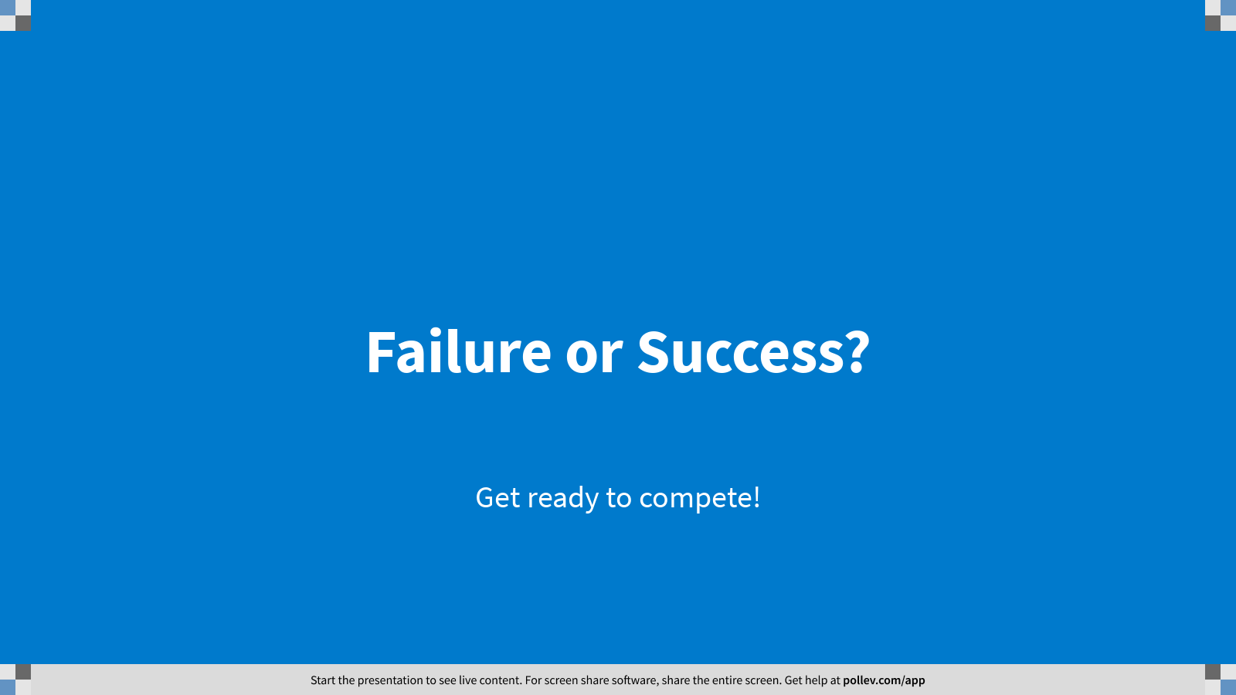
Notes:
Poll Title: Failure or Success?
https://www.polleverywhere.com/competitions/2h1e38romCO4R0DW7c6ro?display_state=welcome&controls=none&onscreen=persist

Slide 43
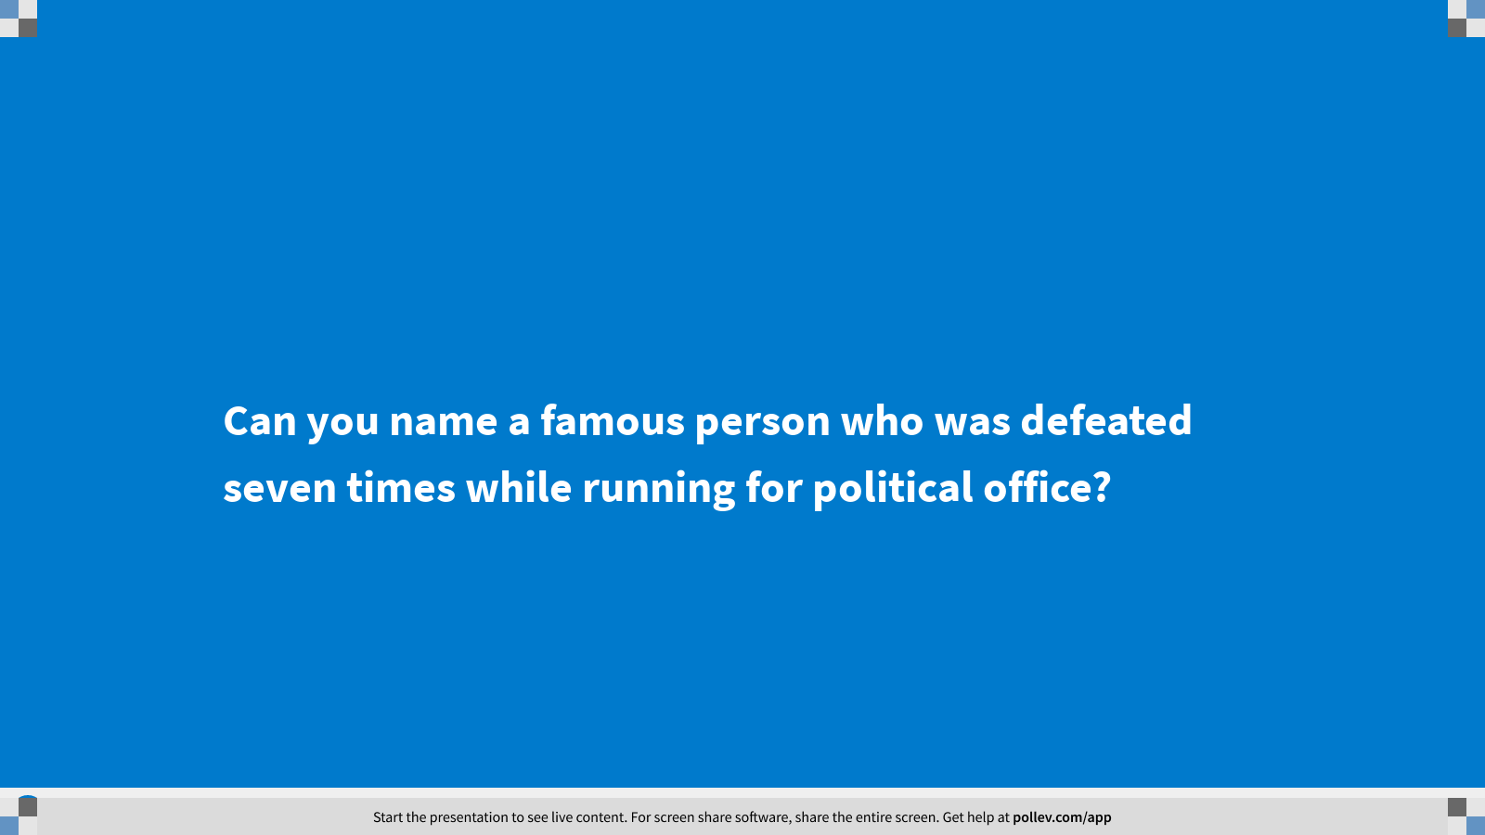
Notes:
Poll Title: Can you name a famous person who was defeated seven times while running for political office?
https://www.polleverywhere.com/multiple_choice_polls/qglr3kuq9mbqFUHs5zf91?display_state=title&controls=none&onscreen=persist

Slide 44
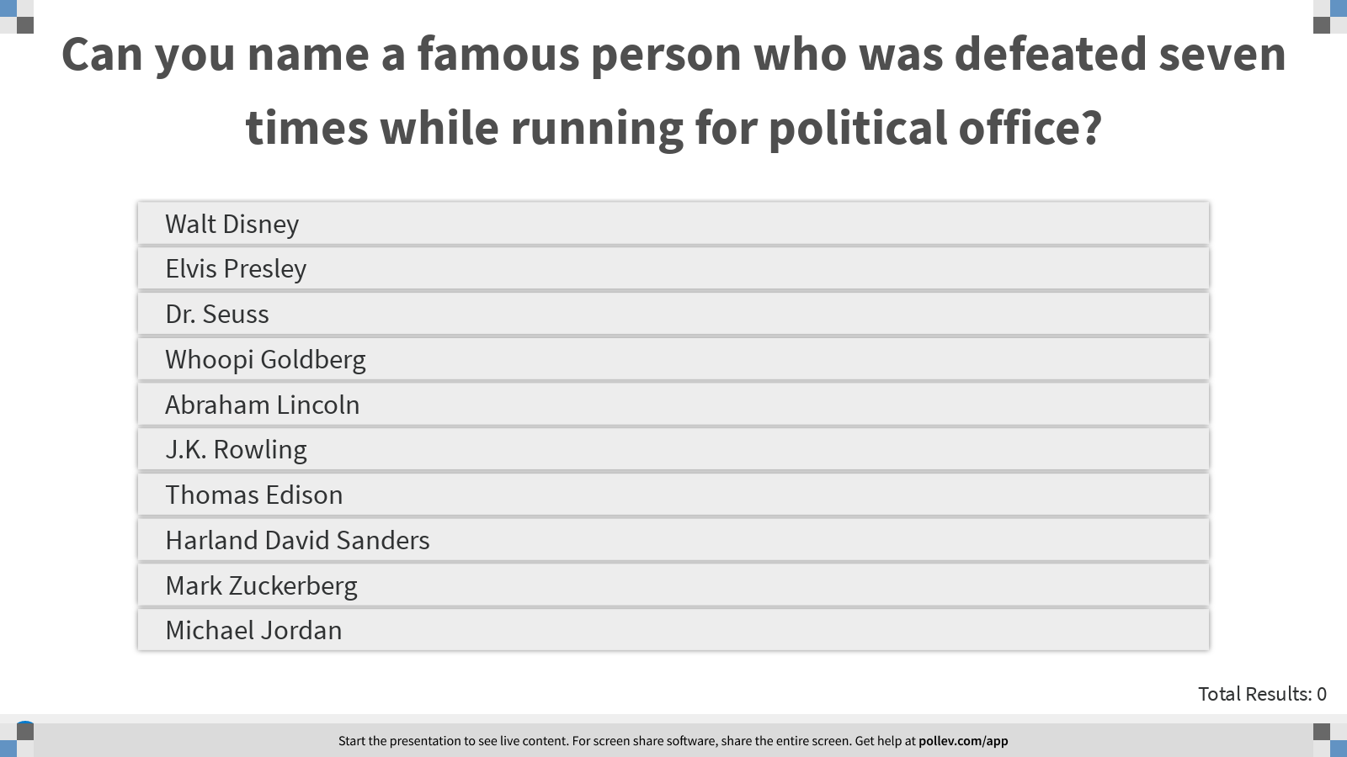
Notes:
Poll Title: Can you name a famous person who was defeated seven times while running for political office?
https://www.polleverywhere.com/multiple_choice_polls/qglr3kuq9mbqFUHs5zf91?display_state=instructions&onscreen=persist

Slide 45
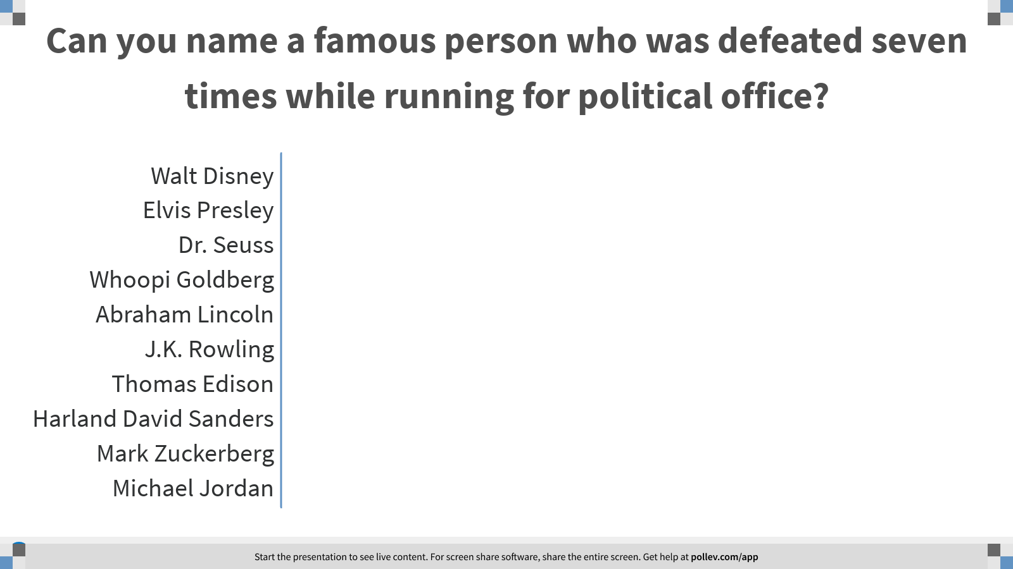
Notes:
Poll Title: Can you name a famous person who was defeated seven times while running for political office?
https://www.polleverywhere.com/multiple_choice_polls/qglr3kuq9mbqFUHs5zf91?display_state=chart&display=correctness&controls=none&onscreen=persist

Slide 46
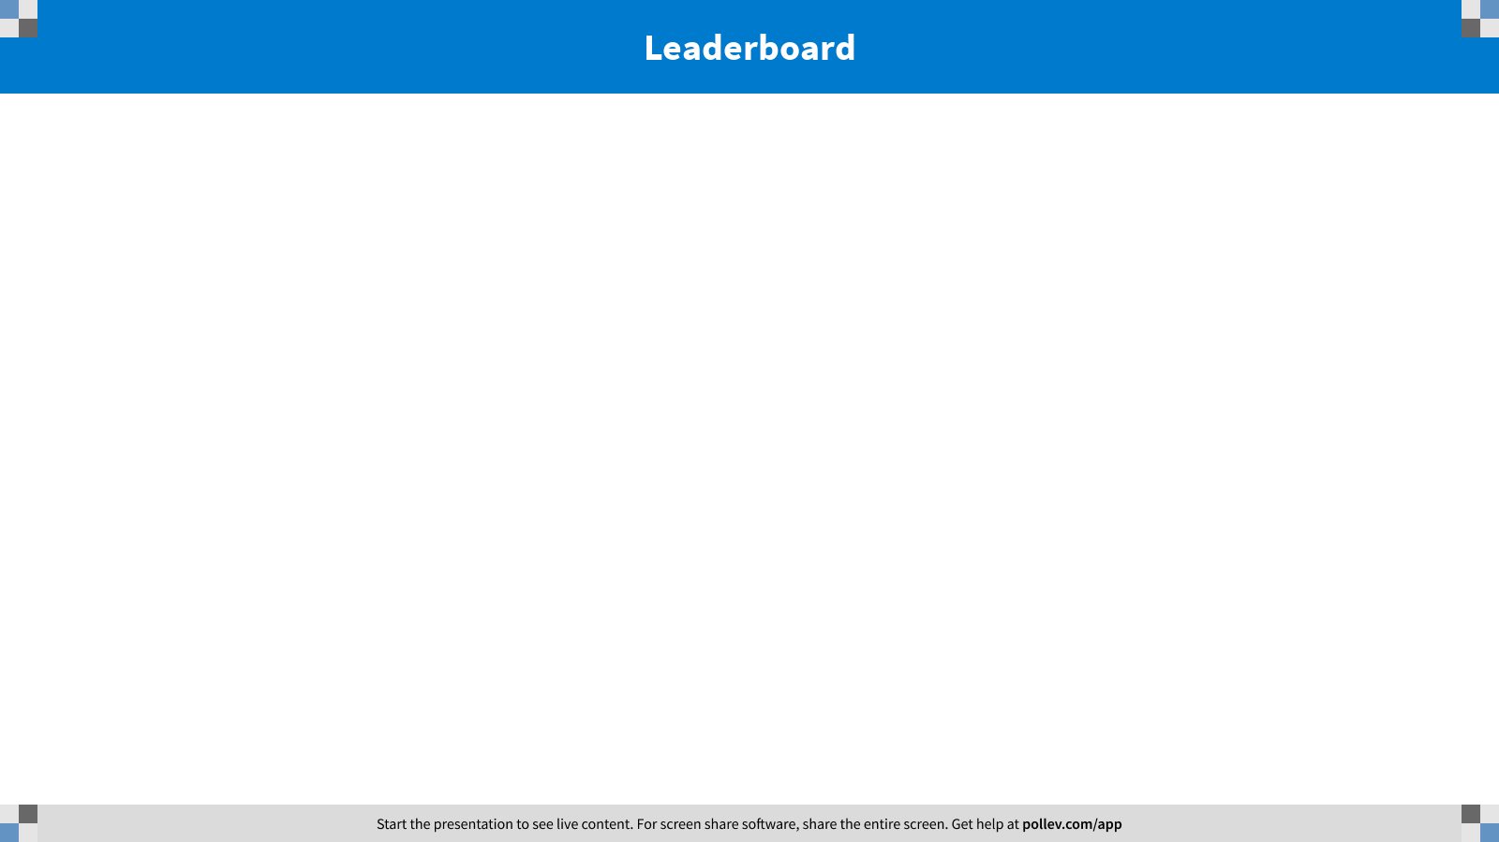
Notes:
Poll Title: Failure or Success?
https://www.polleverywhere.com/competitions/2h1e38romCO4R0DW7c6ro?display_state=leaderboard&onscreen=persist

Slide 47
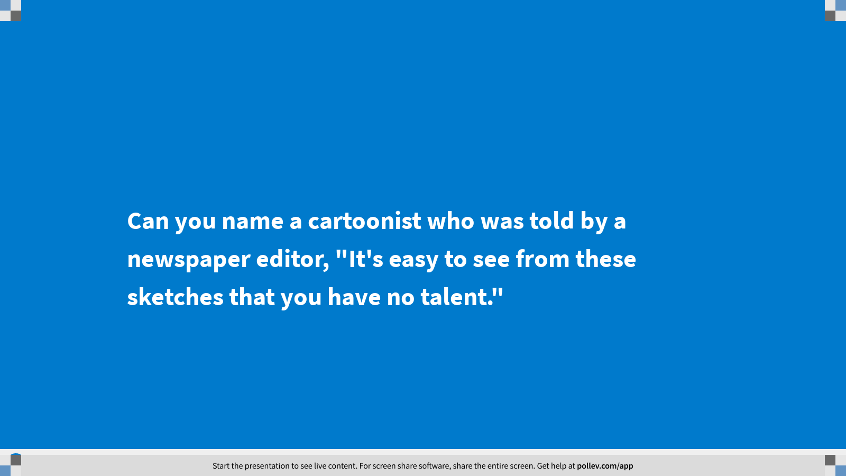
Notes:
Poll Title: Can you name a cartoonist who was told by a newspaper editor, "It's easy to see from these sketches that you have no talent."
https://www.polleverywhere.com/multiple_choice_polls/HaOxH4jeTH10Uk6QeC7dM?display_state=title&controls=none&onscreen=persist

Slide 48
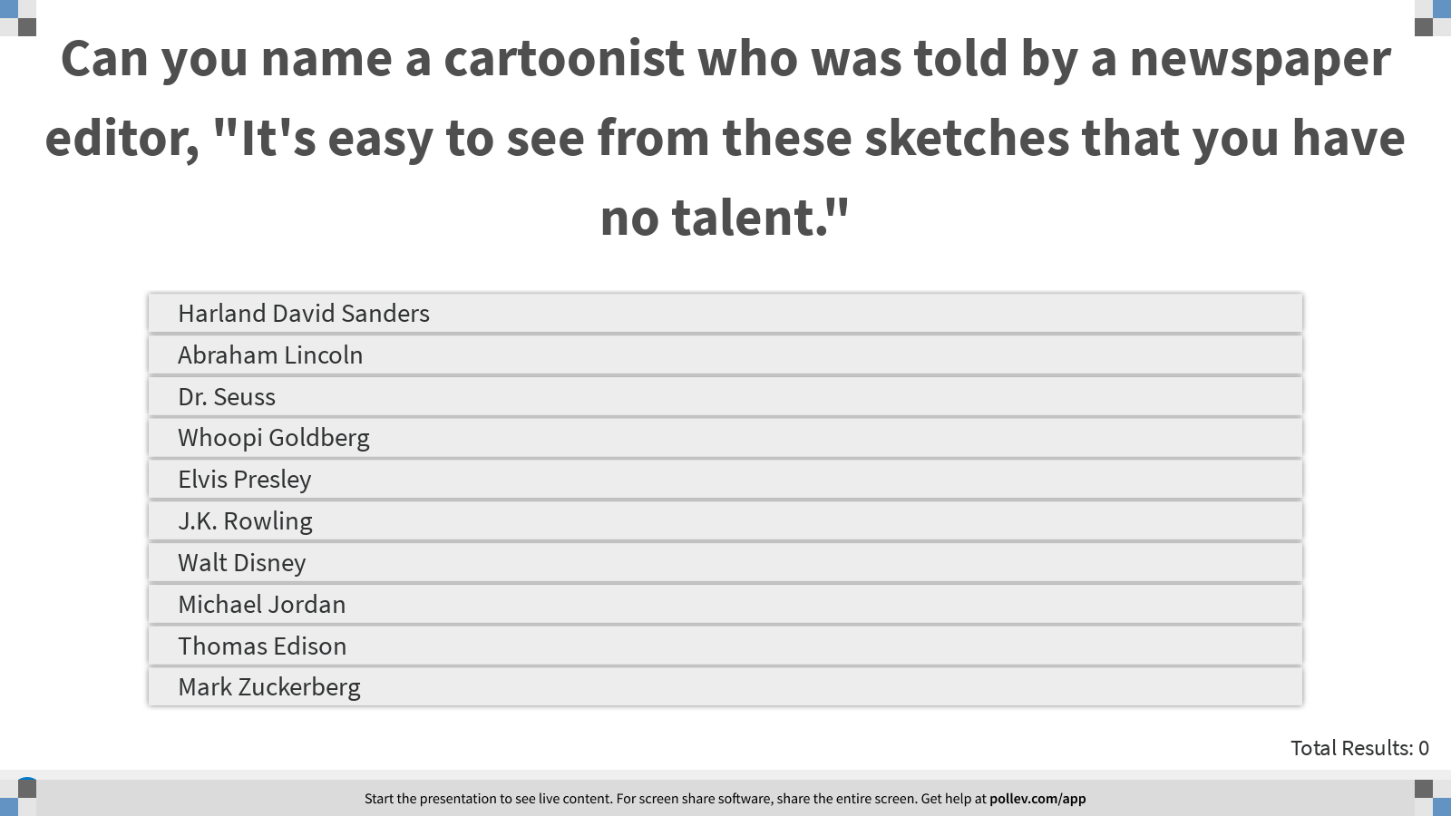
Notes:
Poll Title: Can you name a cartoonist who was told by a newspaper editor, "It's easy to see from these sketches that you have no talent."
https://www.polleverywhere.com/multiple_choice_polls/HaOxH4jeTH10Uk6QeC7dM?display_state=instructions&onscreen=persist

Slide 49
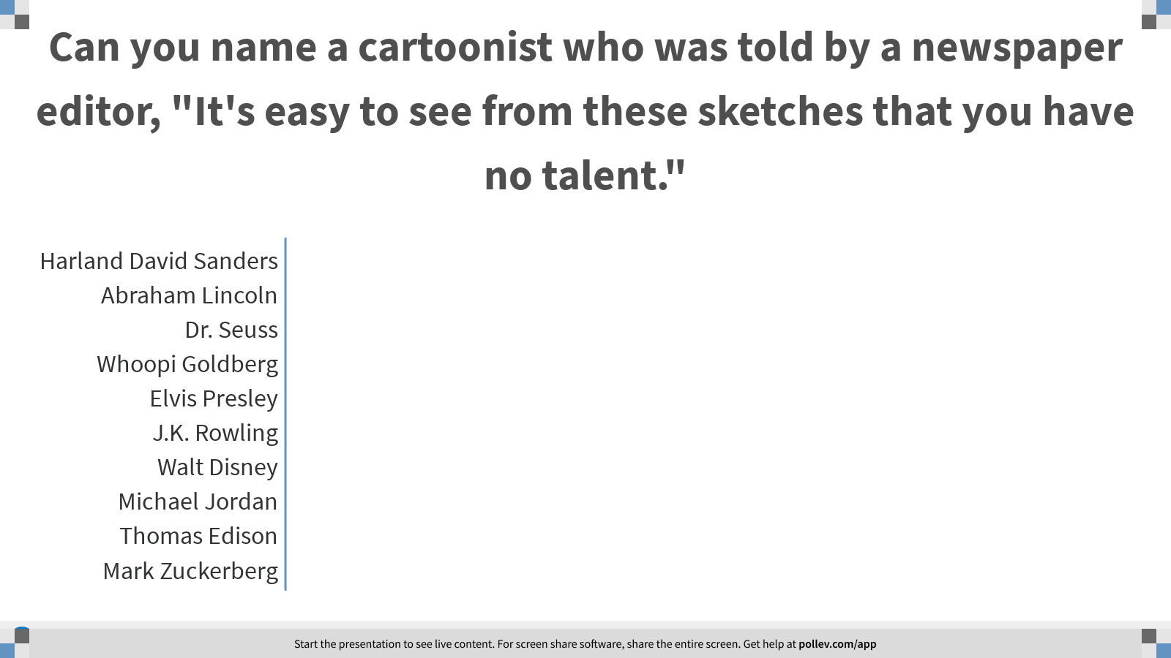
Notes:
Poll Title: Can you name a cartoonist who was told by a newspaper editor, "It's easy to see from these sketches that you have no talent."
https://www.polleverywhere.com/multiple_choice_polls/HaOxH4jeTH10Uk6QeC7dM?display_state=chart&display=correctness&controls=none&onscreen=persist

Slide 50
Notes:
Poll Title: Failure or Success?
https://www.polleverywhere.com/competitions/2h1e38romCO4R0DW7c6ro?display_state=leaderboard&onscreen=persist

Slide 51
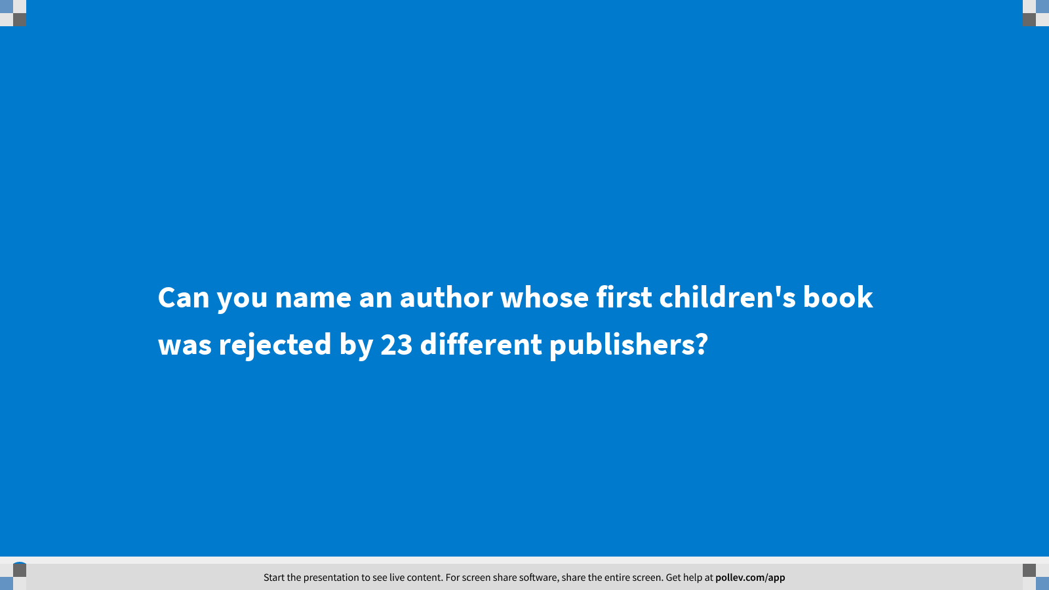
Notes:
Poll Title: Can you name an author whose first children's book was rejected by 23 different publishers?
https://www.polleverywhere.com/multiple_choice_polls/Yk4HpozpvocRHkLbaAqjk?display_state=title&controls=none&onscreen=persist

Slide 52
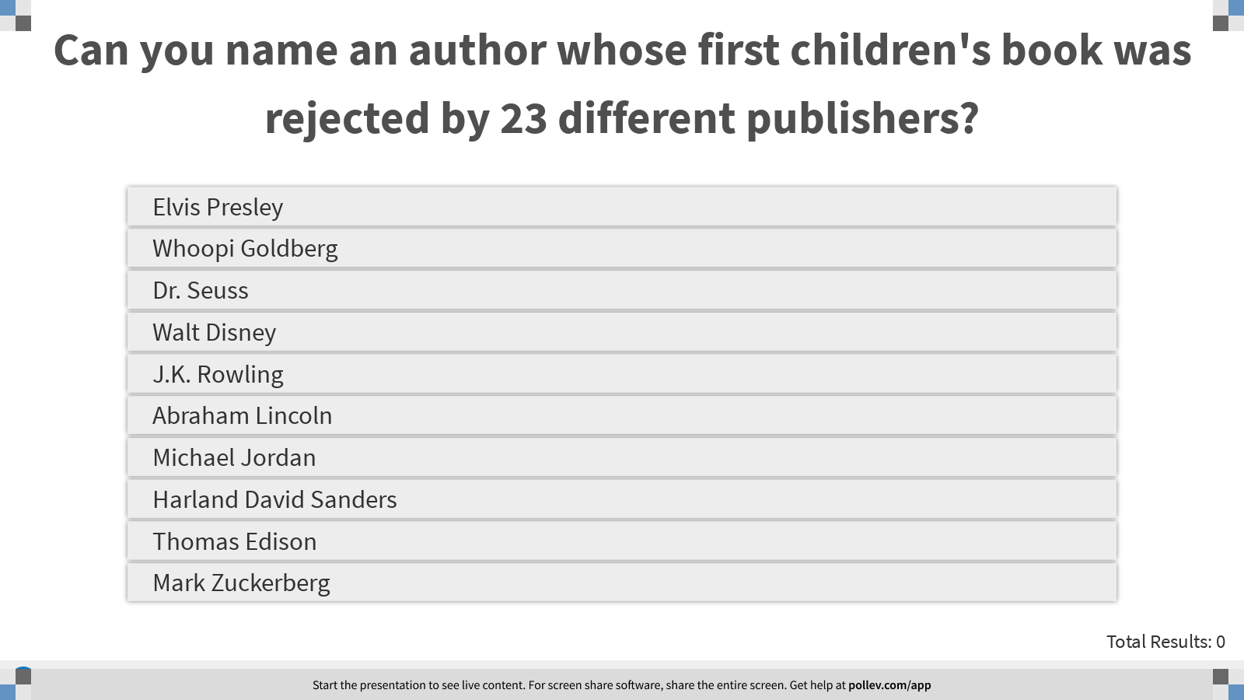
Notes:
Poll Title: Can you name an author whose first children's book was rejected by 23 different publishers?
https://www.polleverywhere.com/multiple_choice_polls/Yk4HpozpvocRHkLbaAqjk?display_state=instructions&onscreen=persist

Slide 53
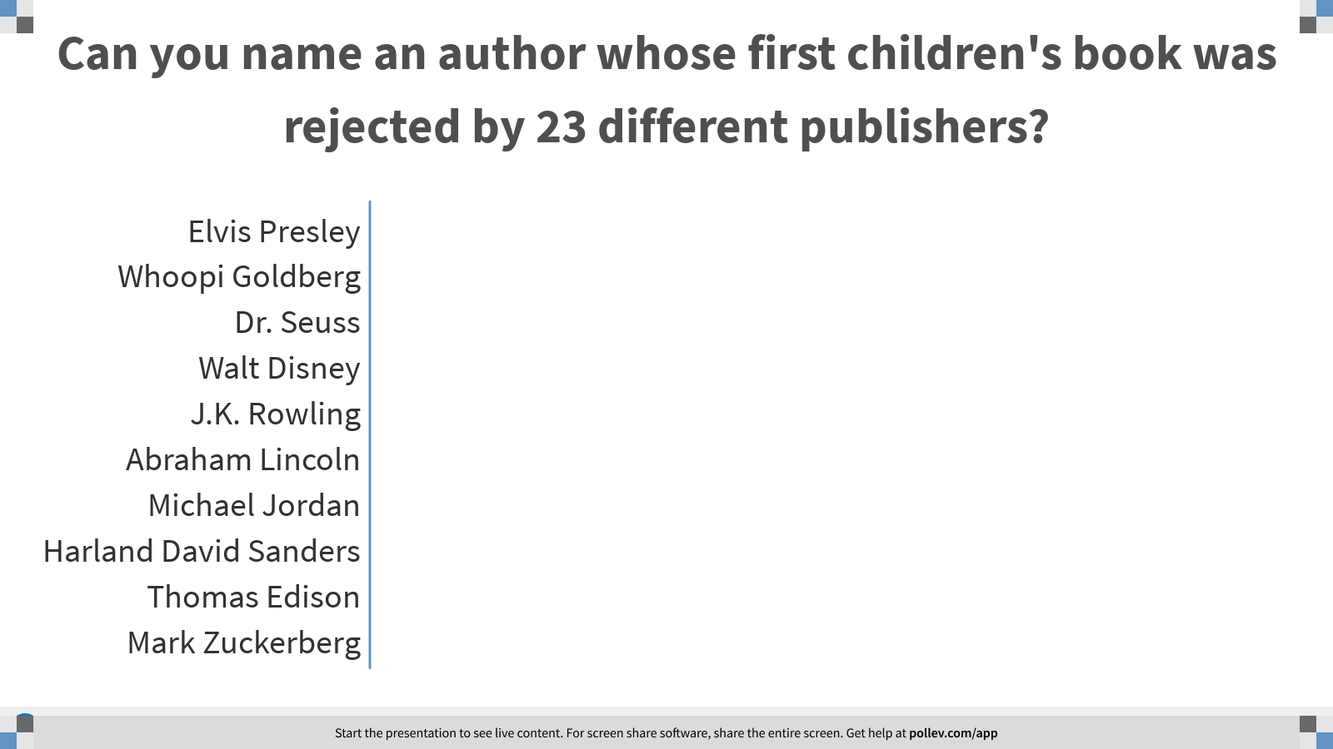
Notes:
Poll Title: Can you name an author whose first children's book was rejected by 23 different publishers?
https://www.polleverywhere.com/multiple_choice_polls/Yk4HpozpvocRHkLbaAqjk?display_state=chart&display=correctness&controls=none&onscreen=persist

Slide 54
Notes:
Poll Title: Failure or Success?
https://www.polleverywhere.com/competitions/2h1e38romCO4R0DW7c6ro?display_state=leaderboard&onscreen=persist

Slide 55
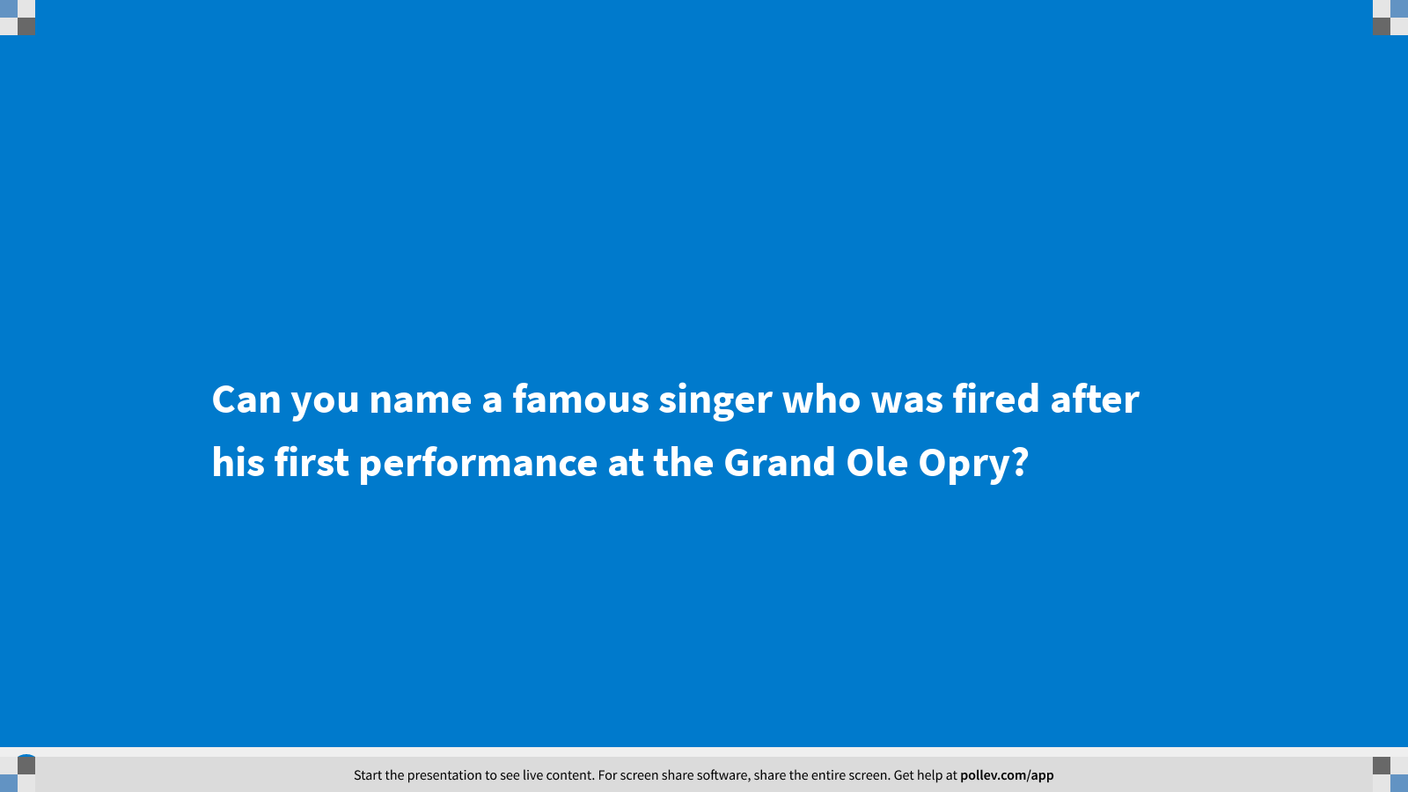
Notes:
Poll Title: Can you name a famous singer who was fired after his first performance at the Grand Ole Opry?
https://www.polleverywhere.com/multiple_choice_polls/8eBoe7Pbc6LDUMruDu8hy?display_state=title&controls=none&onscreen=persist

Slide 56
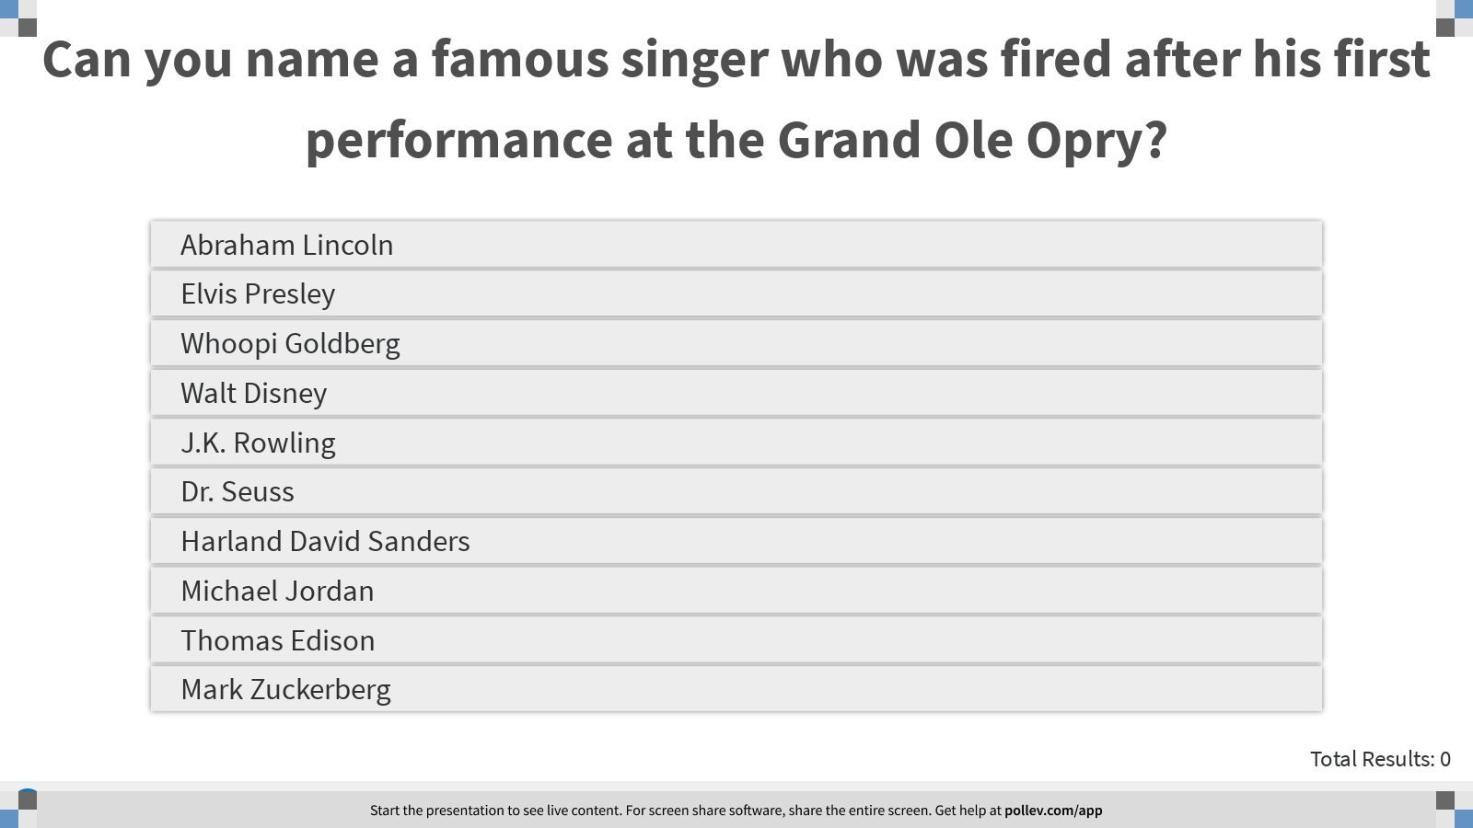
Notes:
Poll Title: Can you name a famous singer who was fired after his first performance at the Grand Ole Opry?
https://www.polleverywhere.com/multiple_choice_polls/8eBoe7Pbc6LDUMruDu8hy?display_state=instructions&onscreen=persist

Slide 57
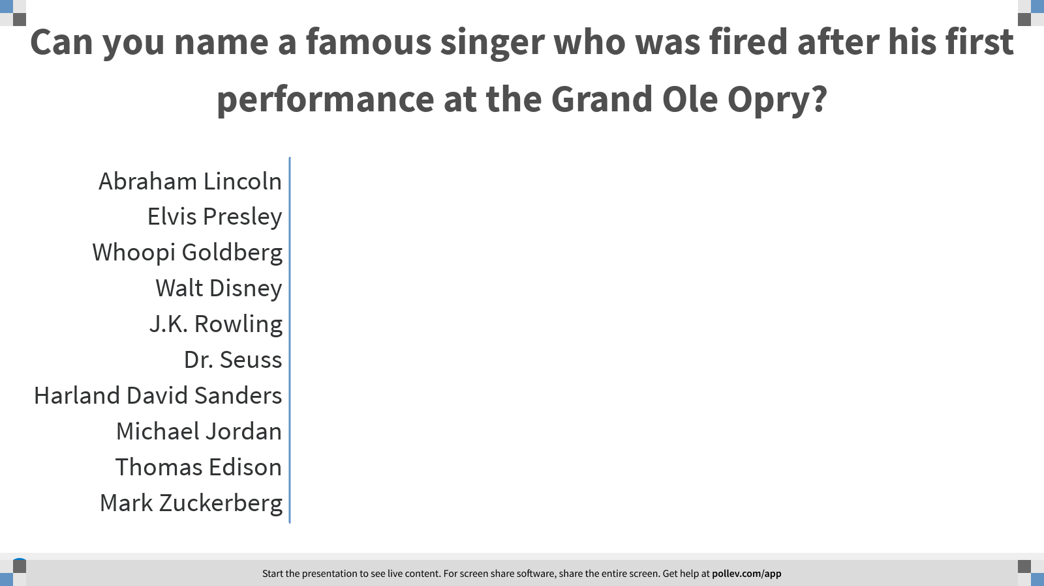
Notes:
Poll Title: Can you name a famous singer who was fired after his first performance at the Grand Ole Opry?
https://www.polleverywhere.com/multiple_choice_polls/8eBoe7Pbc6LDUMruDu8hy?display_state=chart&display=correctness&controls=none&onscreen=persist

Slide 58
Notes:
Poll Title: Failure or Success?
https://www.polleverywhere.com/competitions/2h1e38romCO4R0DW7c6ro?display_state=leaderboard&onscreen=persist

Slide 59
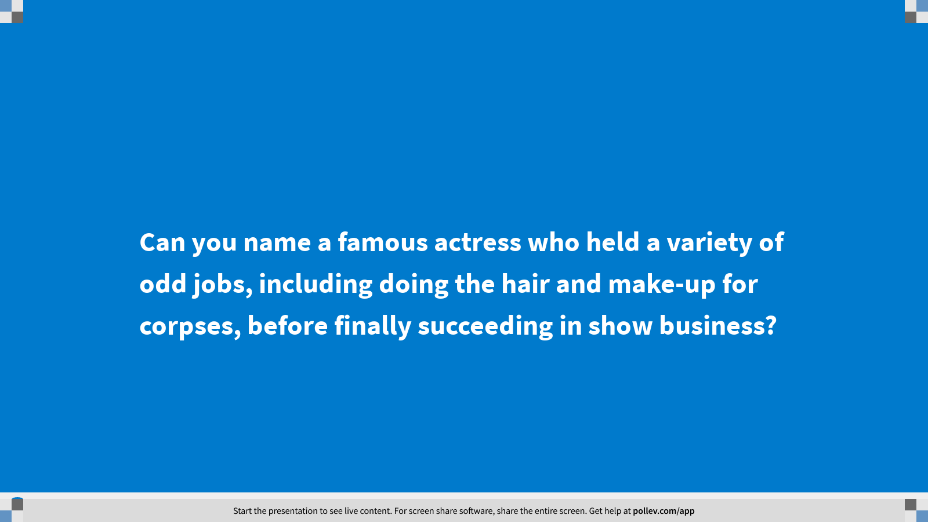
Notes:
Poll Title: Can you name a famous actress who held a variety of odd jobs, including doing the hair and make-up for corpses, before finally succeeding in show business?
https://www.polleverywhere.com/multiple_choice_polls/qBowlYnHwlrMFpmzRLcqs?display_state=title&controls=none&onscreen=persist

Slide 60
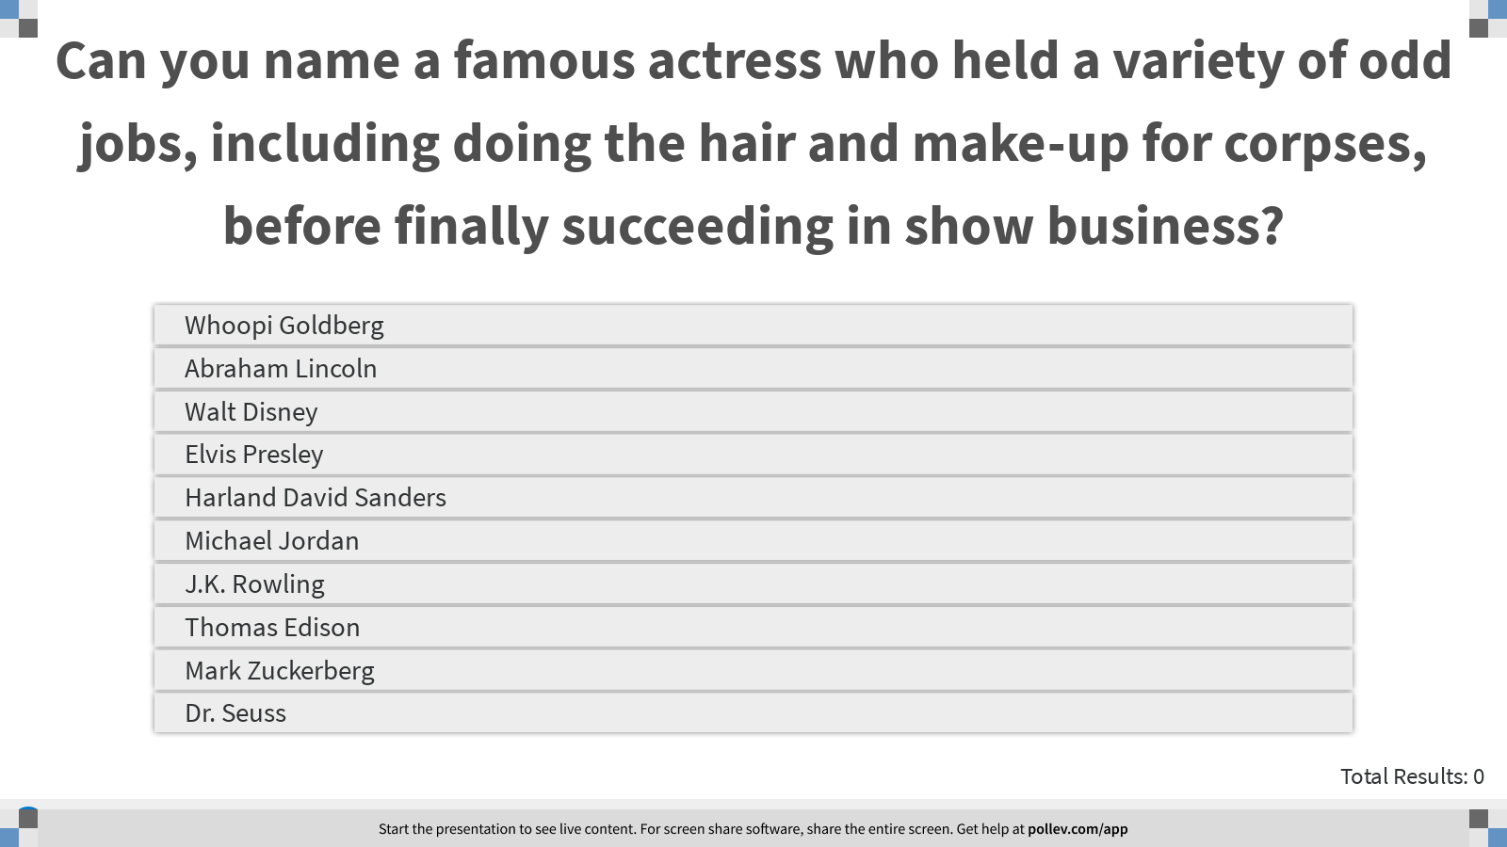
Notes:
Poll Title: Can you name a famous actress who held a variety of odd jobs, including doing the hair and make-up for corpses, before finally succeeding in show business?
https://www.polleverywhere.com/multiple_choice_polls/qBowlYnHwlrMFpmzRLcqs?display_state=instructions&onscreen=persist

Slide 61
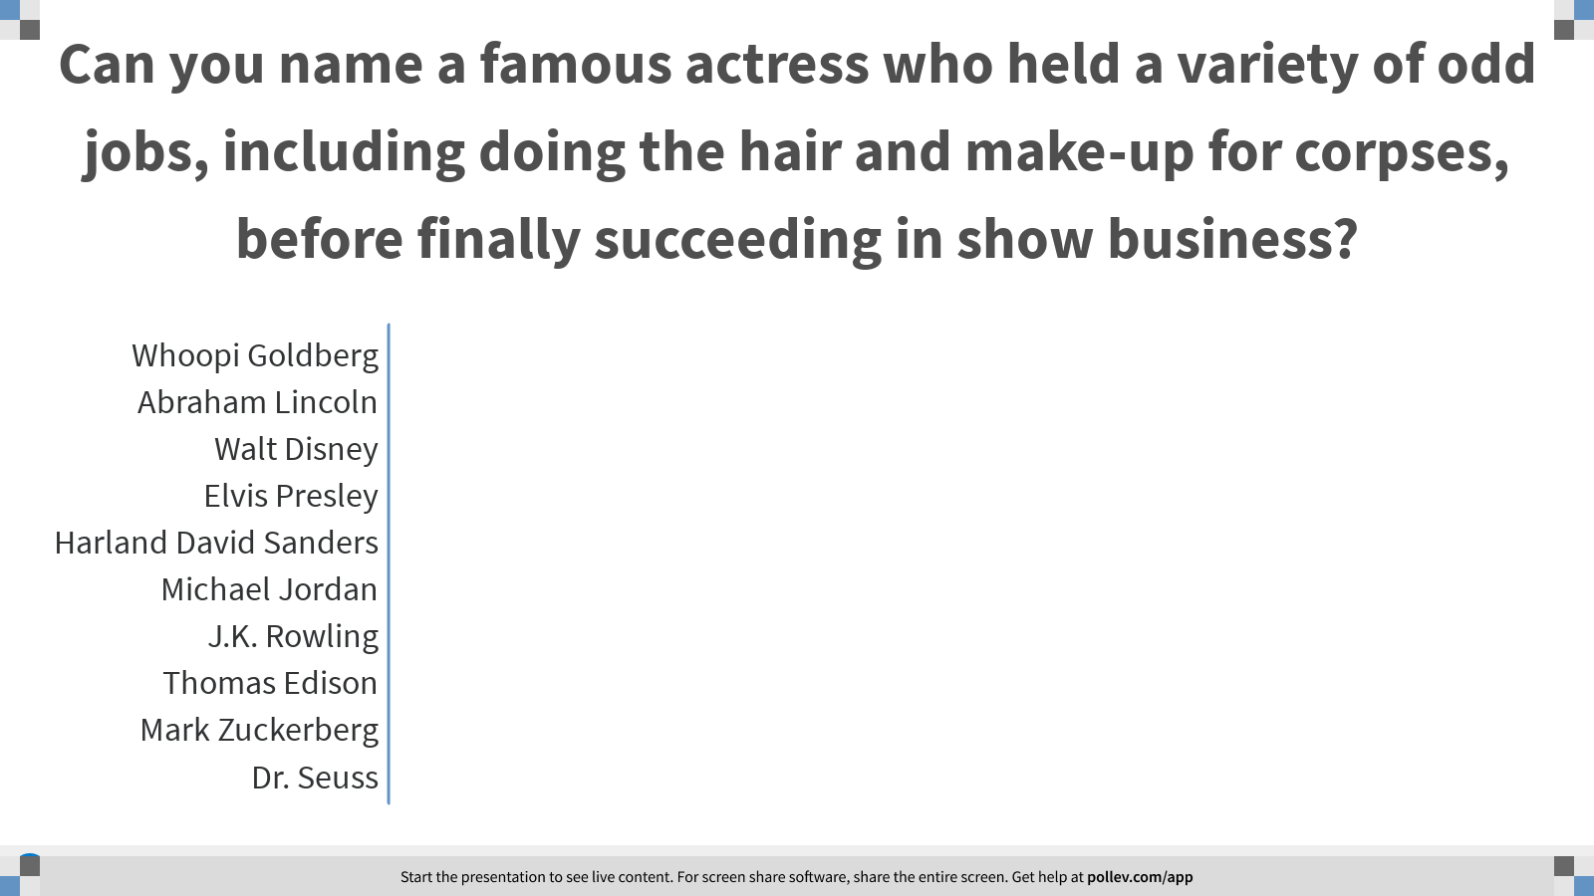
Notes:
Poll Title: Can you name a famous actress who held a variety of odd jobs, including doing the hair and make-up for corpses, before finally succeeding in show business?
https://www.polleverywhere.com/multiple_choice_polls/qBowlYnHwlrMFpmzRLcqs?display_state=chart&display=correctness&controls=none&onscreen=persist

Slide 62
Notes:
Poll Title: Failure or Success?
https://www.polleverywhere.com/competitions/2h1e38romCO4R0DW7c6ro?display_state=leaderboard&onscreen=persist

Slide 63
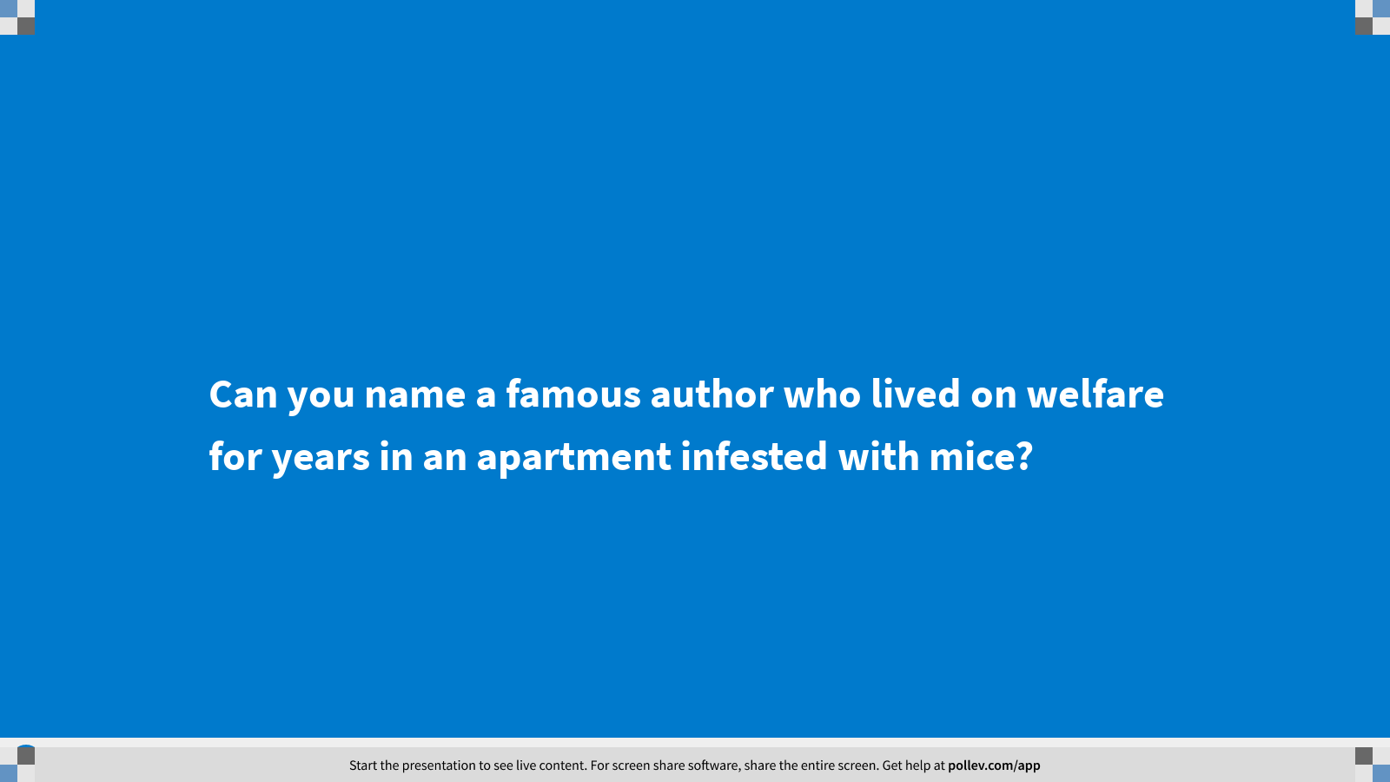
Notes:
Poll Title: Can you name a famous author who lived on welfare for years in an apartment infested with mice?
https://www.polleverywhere.com/multiple_choice_polls/BfgAkKffF0kqT96B0E9au?display_state=title&controls=none&onscreen=persist

Slide 64
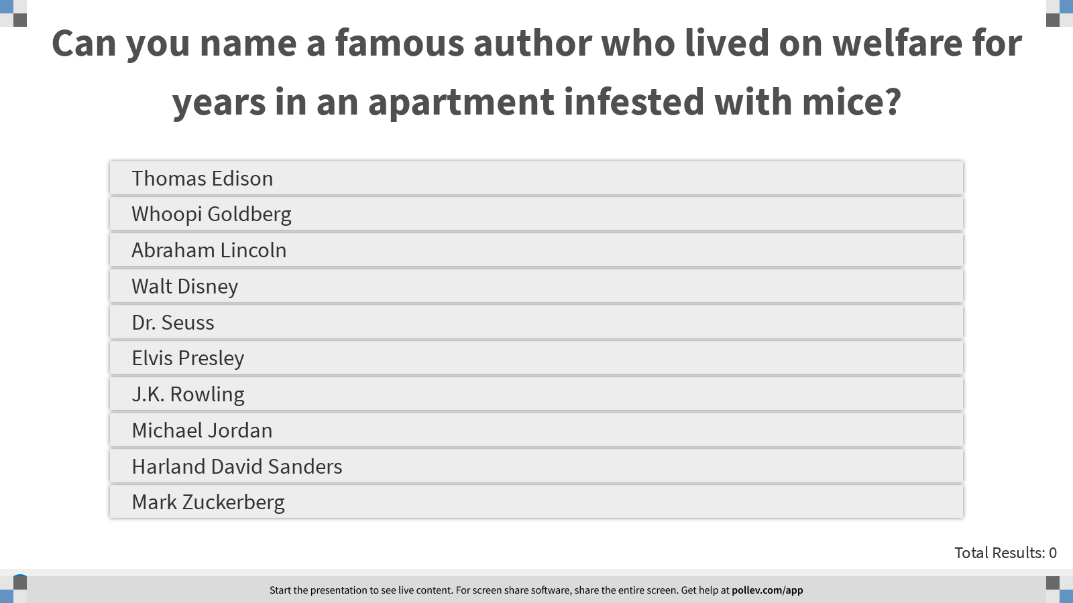
Notes:
Poll Title: Can you name a famous author who lived on welfare for years in an apartment infested with mice?
https://www.polleverywhere.com/multiple_choice_polls/BfgAkKffF0kqT96B0E9au?display_state=instructions&onscreen=persist

Slide 65
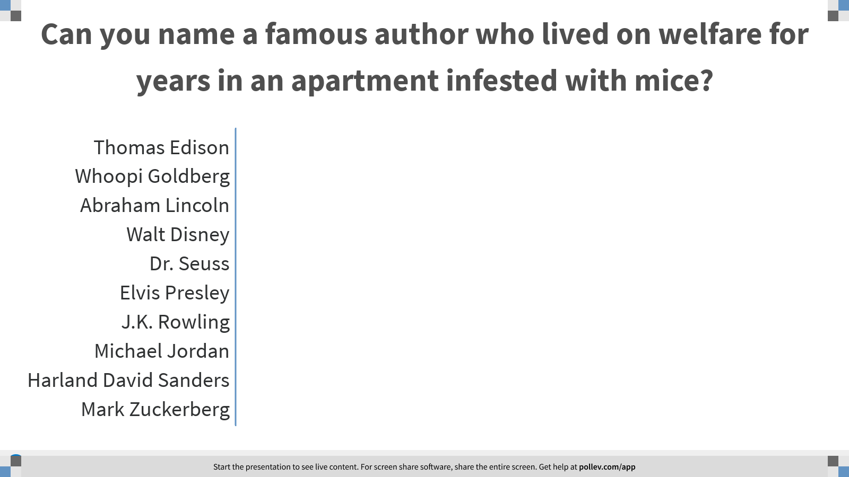
Notes:
Poll Title: Can you name a famous author who lived on welfare for years in an apartment infested with mice?
https://www.polleverywhere.com/multiple_choice_polls/BfgAkKffF0kqT96B0E9au?display_state=chart&display=correctness&controls=none&onscreen=persist

Slide 66
Notes:
Poll Title: Failure or Success?
https://www.polleverywhere.com/competitions/2h1e38romCO4R0DW7c6ro?display_state=leaderboard&onscreen=persist

Slide 67
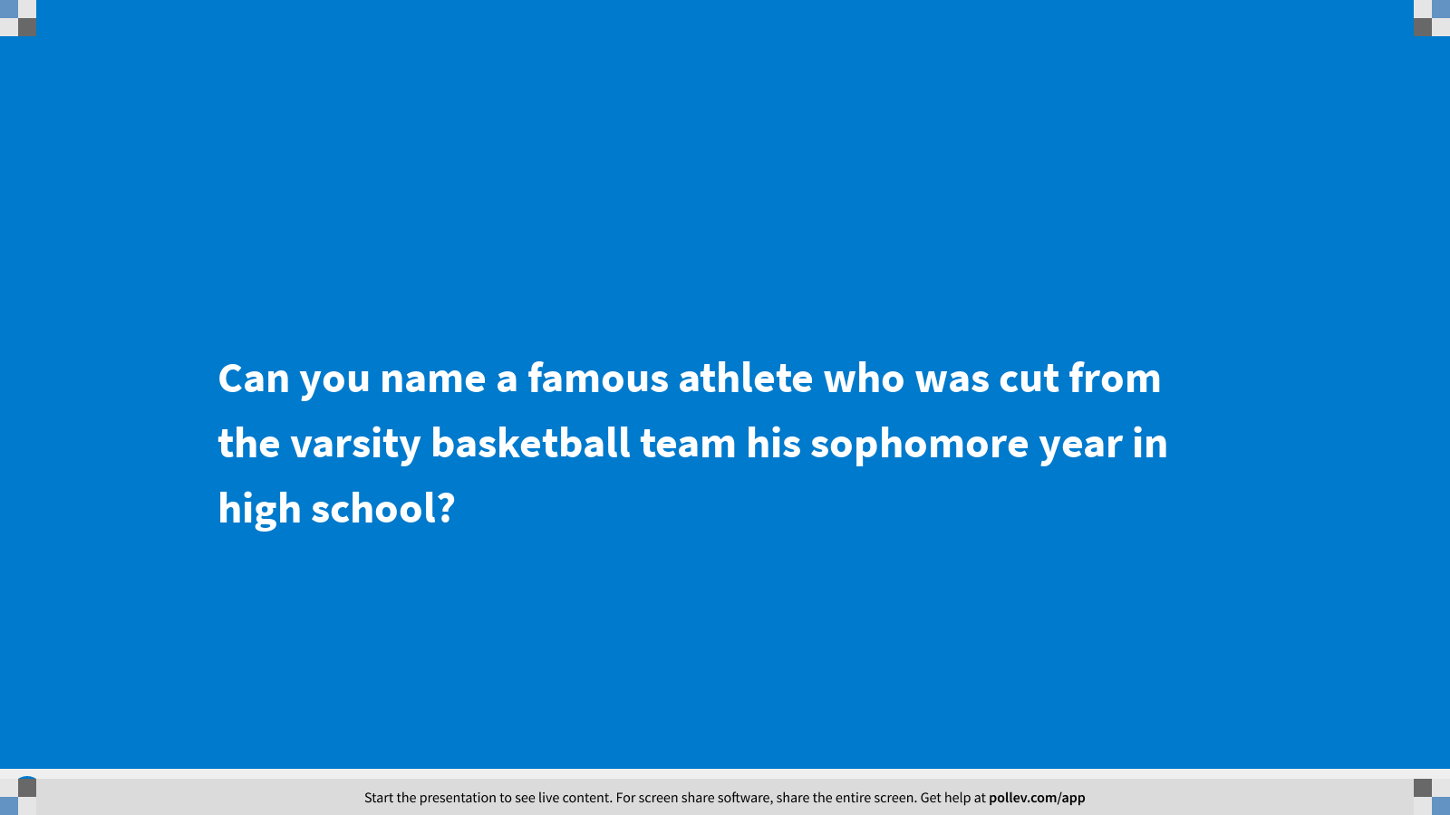
Notes:
Poll Title: Can you name a famous athlete who was cut from the varsity basketball team his sophomore year in high school?
https://www.polleverywhere.com/multiple_choice_polls/IgIbVVk3fC4nTcOxHkwPt?display_state=title&controls=none&onscreen=persist

Slide 68
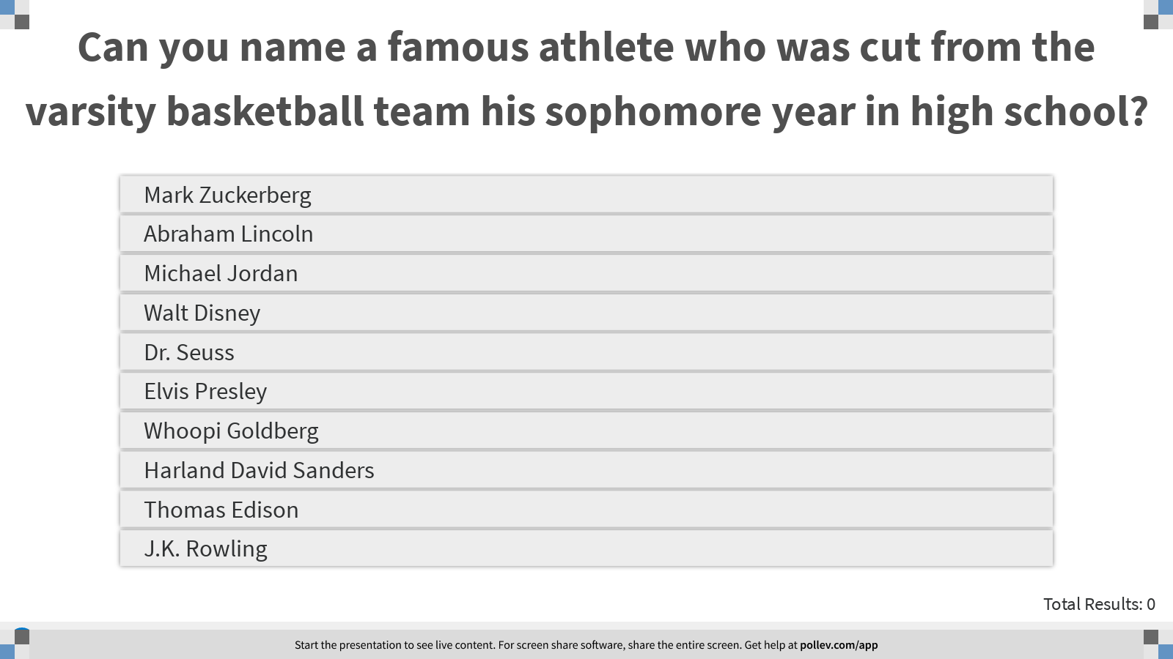
Notes:
Poll Title: Can you name a famous athlete who was cut from the varsity basketball team his sophomore year in high school?
https://www.polleverywhere.com/multiple_choice_polls/IgIbVVk3fC4nTcOxHkwPt?display_state=instructions&onscreen=persist

Slide 69
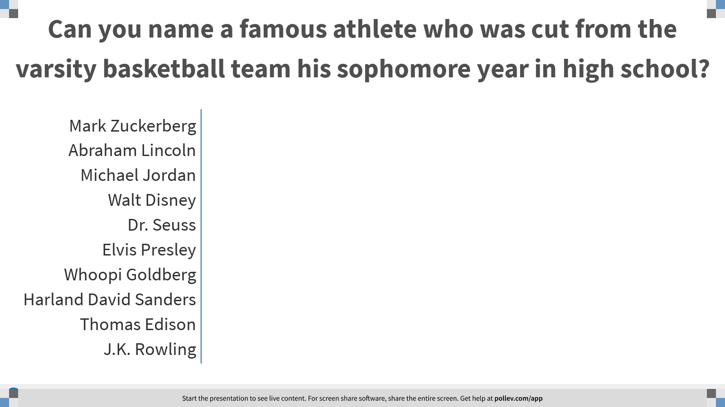
Notes:
Poll Title: Can you name a famous athlete who was cut from the varsity basketball team his sophomore year in high school?
https://www.polleverywhere.com/multiple_choice_polls/IgIbVVk3fC4nTcOxHkwPt?display_state=chart&display=correctness&controls=none&onscreen=persist

Slide 70
Notes:
Poll Title: Failure or Success?
https://www.polleverywhere.com/competitions/2h1e38romCO4R0DW7c6ro?display_state=leaderboard&onscreen=persist

Slide 71
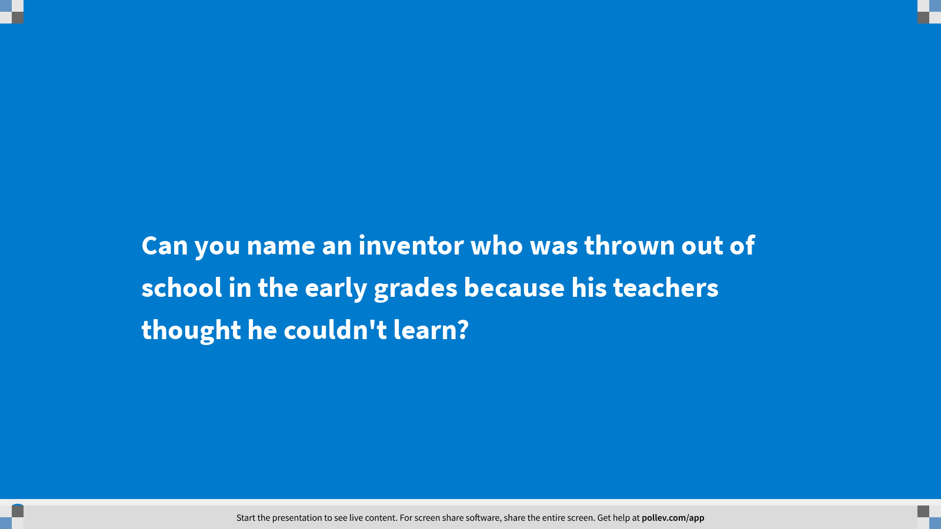
Notes:
Poll Title: Can you name an inventor who was thrown out of school in the early grades because his teachers thought he couldn't learn?
https://www.polleverywhere.com/multiple_choice_polls/ktO42bOKXpki9wAQIw4oq?display_state=title&controls=none&onscreen=persist

Slide 72
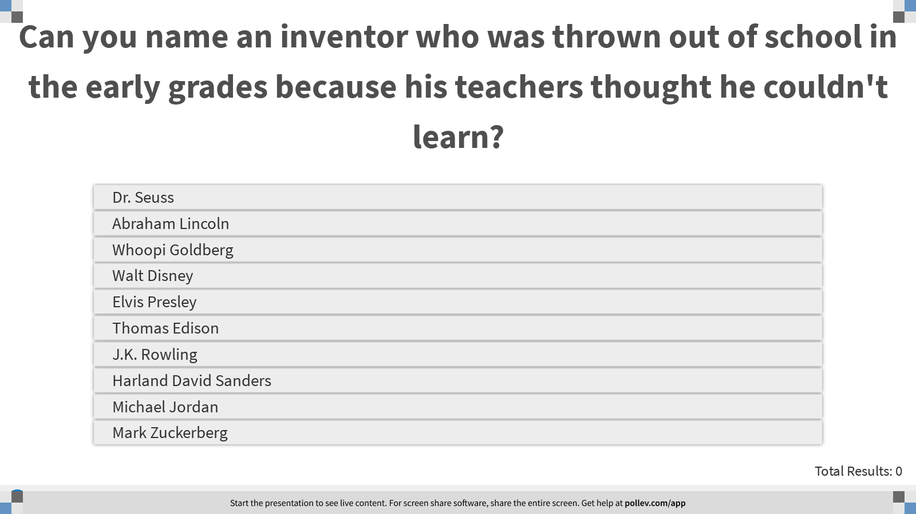
Notes:
Poll Title: Can you name an inventor who was thrown out of school in the early grades because his teachers thought he couldn't learn?
https://www.polleverywhere.com/multiple_choice_polls/ktO42bOKXpki9wAQIw4oq?display_state=instructions&onscreen=persist

Slide 73
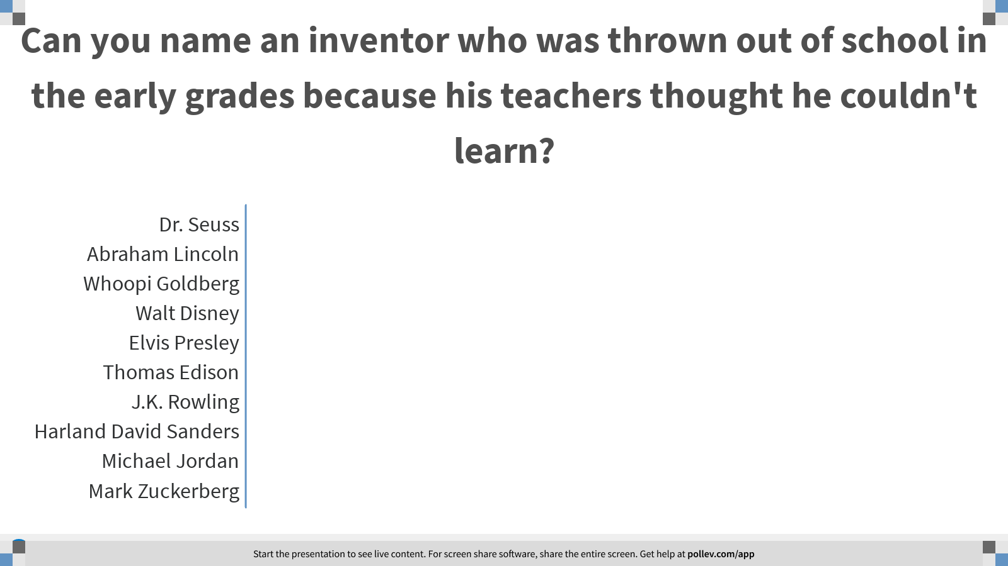
Notes:
Poll Title: Can you name an inventor who was thrown out of school in the early grades because his teachers thought he couldn't learn?
https://www.polleverywhere.com/multiple_choice_polls/ktO42bOKXpki9wAQIw4oq?display_state=chart&display=correctness&controls=none&onscreen=persist

Slide 74
Notes:
Poll Title: Failure or Success?
https://www.polleverywhere.com/competitions/2h1e38romCO4R0DW7c6ro?display_state=leaderboard&onscreen=persist

Slide 75

Notes:
Poll Title: Can you name a famous Harvard University drop out?
https://www.polleverywhere.com/multiple_choice_polls/al7ECwV0hcAJpOgBi12dp?display_state=title&controls=none&onscreen=persist

Slide 76
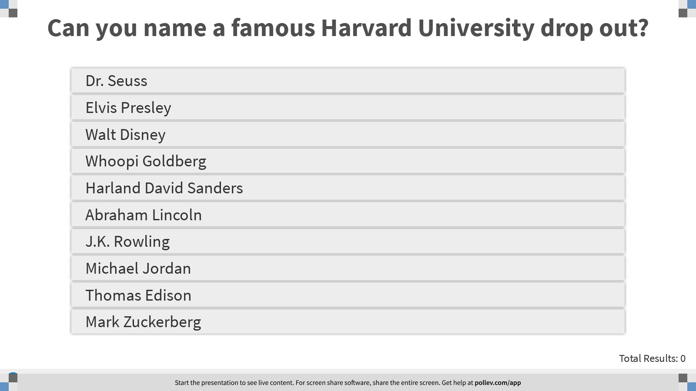
Notes:
Poll Title: Can you name a famous Harvard University drop out?
https://www.polleverywhere.com/multiple_choice_polls/al7ECwV0hcAJpOgBi12dp?display_state=instructions&onscreen=persist

Slide 77
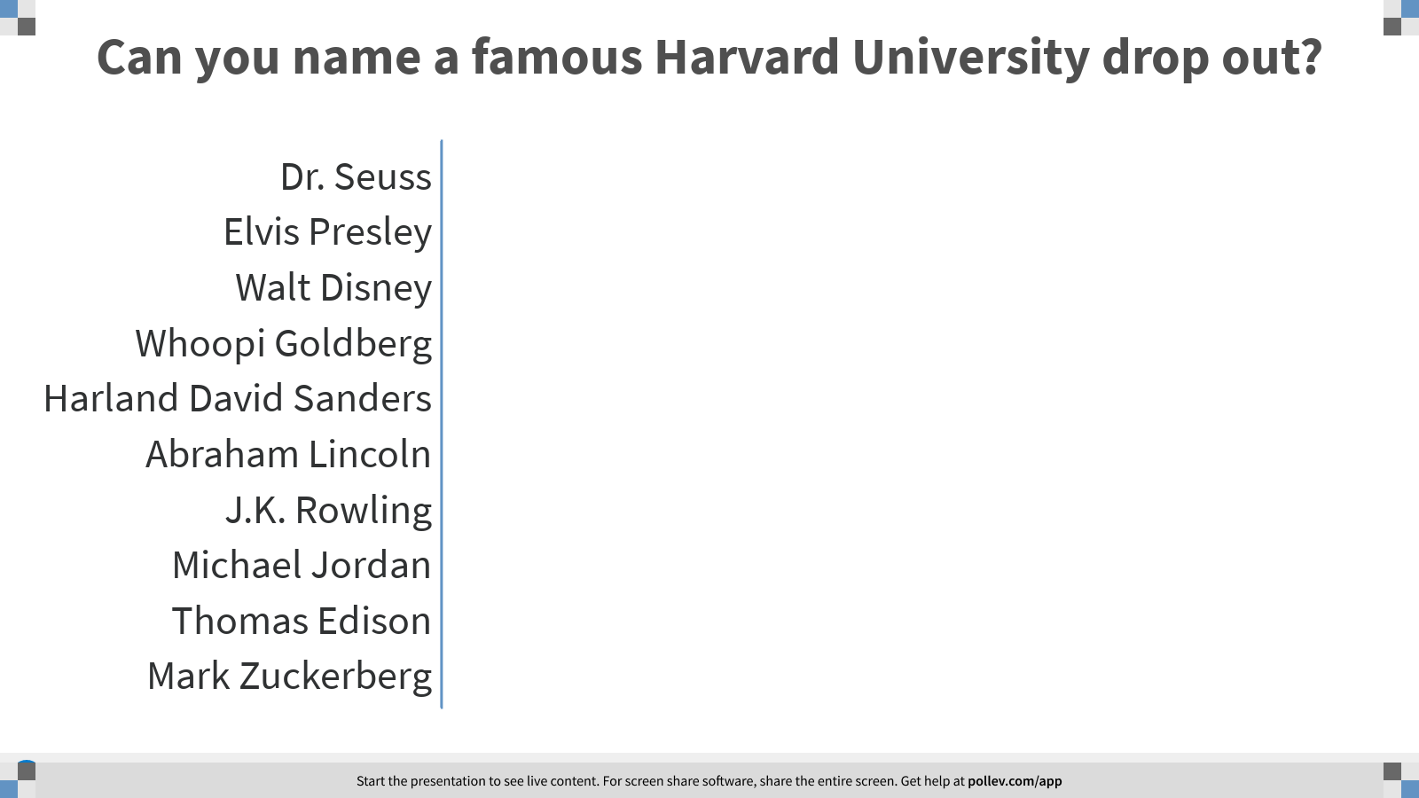
Notes:
Poll Title: Can you name a famous Harvard University drop out?
https://www.polleverywhere.com/multiple_choice_polls/al7ECwV0hcAJpOgBi12dp?display_state=chart&display=correctness&controls=none&onscreen=persist

Slide 78
Notes:
Poll Title: Failure or Success?
https://www.polleverywhere.com/competitions/2h1e38romCO4R0DW7c6ro?display_state=leaderboard&onscreen=persist

Slide 79
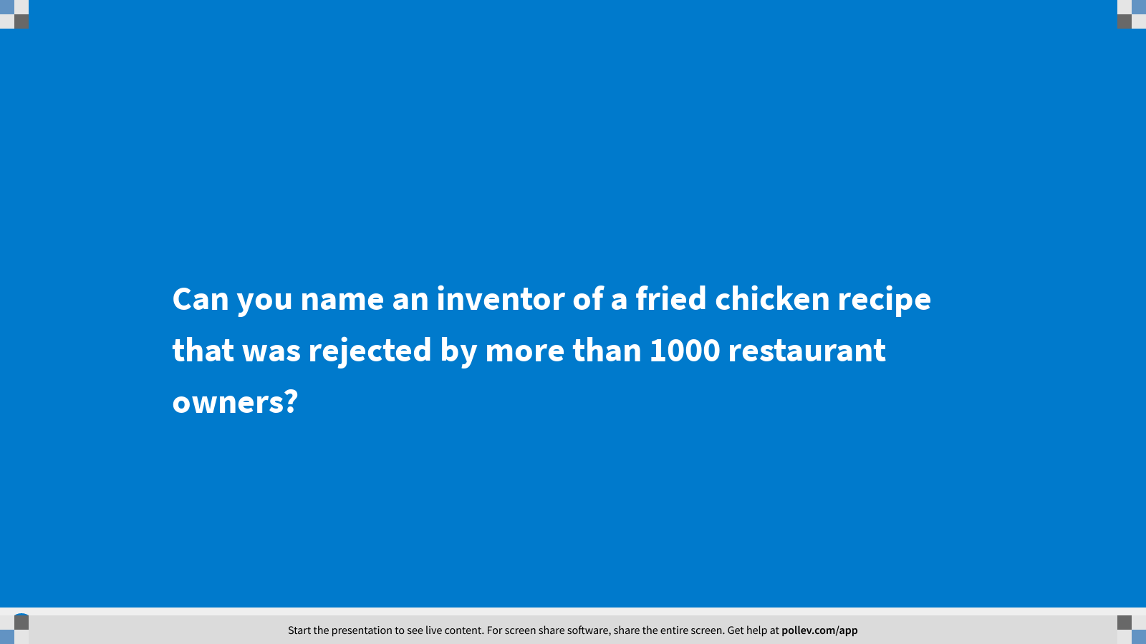
Notes:
Poll Title: Can you name an inventor of a fried chicken recipe that was rejected by more than 1000 restaurant owners?
https://www.polleverywhere.com/multiple_choice_polls/zU71pb7ATDqbApQK3MFwh?display_state=title&controls=none&onscreen=persist

Slide 80
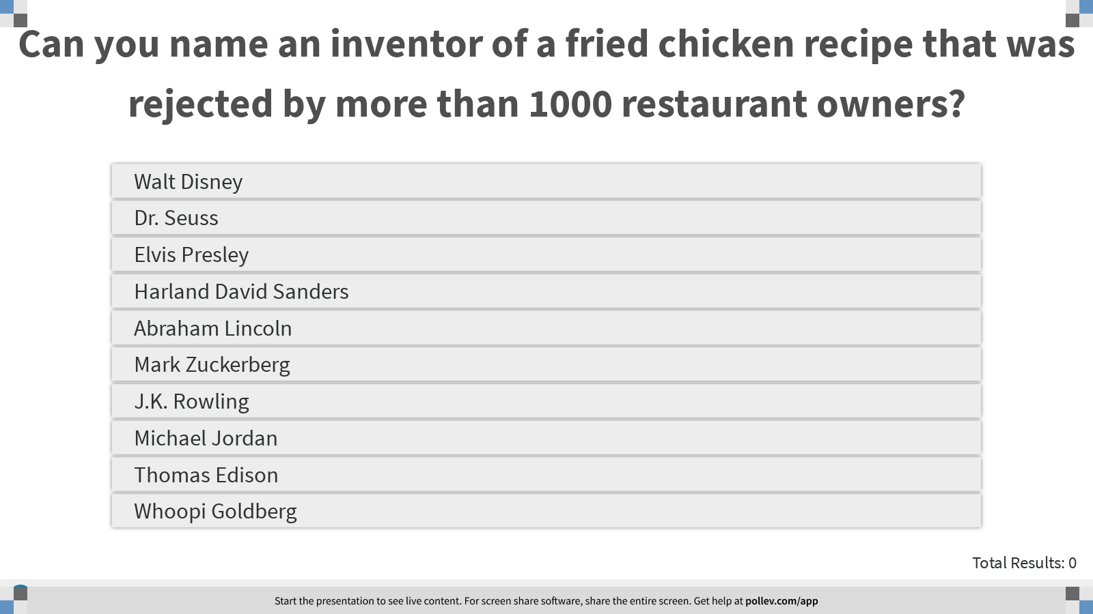
Notes:
Poll Title: Can you name an inventor of a fried chicken recipe that was rejected by more than 1000 restaurant owners?
https://www.polleverywhere.com/multiple_choice_polls/zU71pb7ATDqbApQK3MFwh?display_state=instructions&onscreen=persist

Slide 81
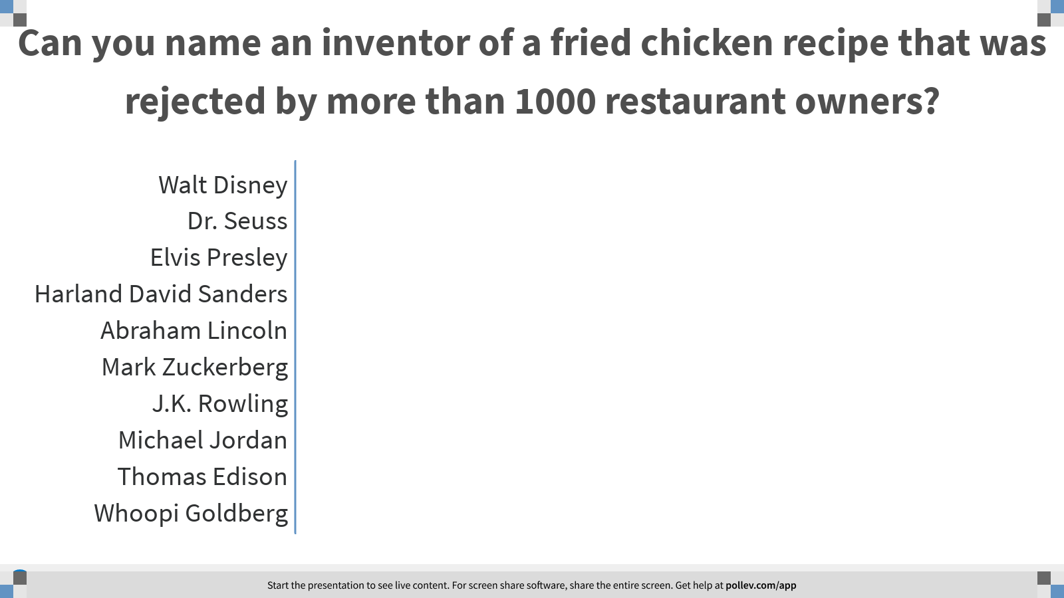
Notes:
Poll Title: Can you name an inventor of a fried chicken recipe that was rejected by more than 1000 restaurant owners?
https://www.polleverywhere.com/multiple_choice_polls/zU71pb7ATDqbApQK3MFwh?display_state=chart&display=correctness&controls=none&onscreen=persist

Slide 82
Notes:
Poll Title: Failure or Success?
https://www.polleverywhere.com/competitions/2h1e38romCO4R0DW7c6ro?display_state=finale&onscreen=persist

Slide 83
Teamwork
Coming together is a beginning; keeping together is progress; working together is success.
Henry Ford

Slide 84
The ability to work as part of a team is one of the most important skills in today’s job market. Employers are looking for workers who can contribute their own ideas, but also want people who can work with others to create and develop projects and plans.
Teamwork involves building relationships and working with other people using several important skills and habits:
Healthy respect for different opinions, customs, and individual preferences
Working cooperatively
Contributing to groups with ideas, suggestions, and effort
Communication (both giving and receiving)
Sense of responsibility
Ability to participate in group decision-making⁵

Slide 85

Elements of Teamwork – An Inventory of Skills
Part of being a good team member is learning how to understand your personal strengths (what you have to offer) AND where you might need to draw assistance from others. The next poll consists of 10 of the characteristics that make a productive team member. Rate your level of confidence in each skill (HONESTLY) – and then devise a plan for how you can improve some of the areas you think might need a “jump start.”
Least confident -------- Most confident

Slide 86
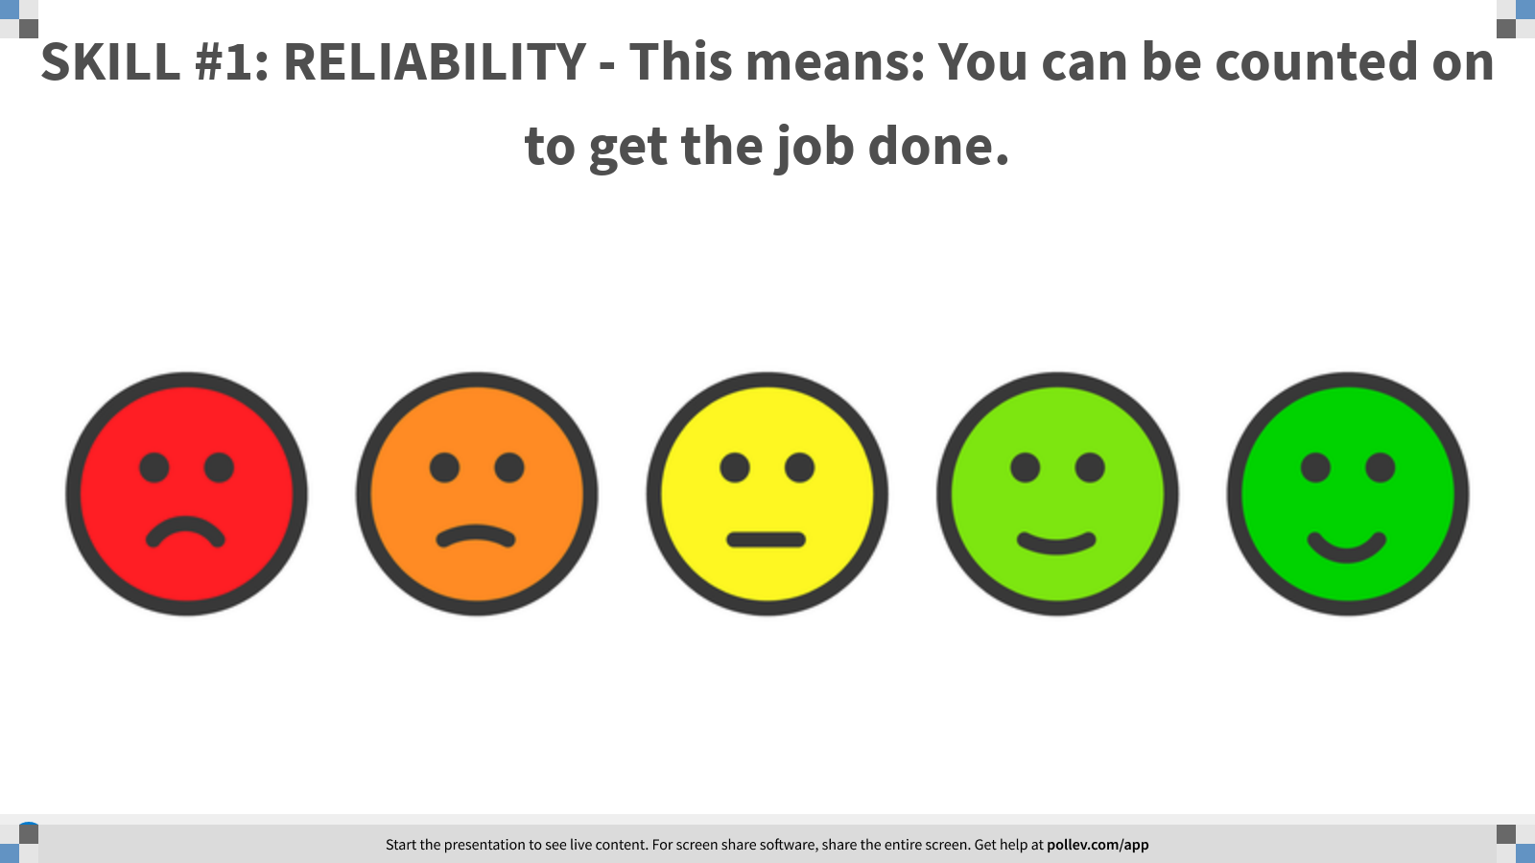
Notes:
Poll Title: SKILL #1: RELIABILITY - This means: You can be counted on to get the job done.
https://www.polleverywhere.com/clickable_images/jAvjl1NvdVwoclD5j7jhb

Slide 87
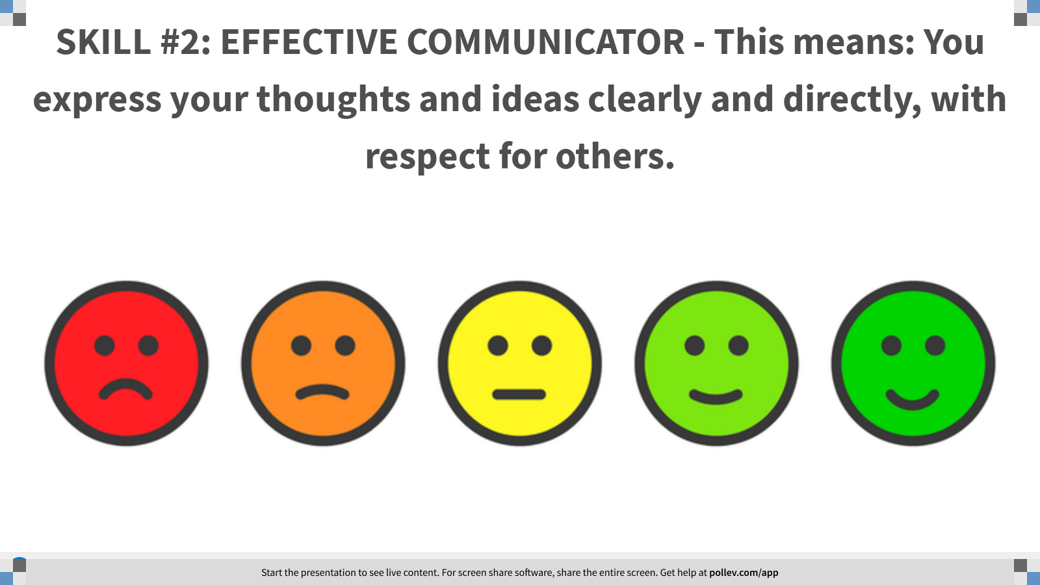
Notes:
Poll Title: SKILL #2: EFFECTIVE COMMUNICATOR - This means: You express your thoughts and ideas clearly and directly, with respect for others.
https://www.polleverywhere.com/clickable_images/g4cvUdPUJzW4RRzorBuTQ

Slide 88
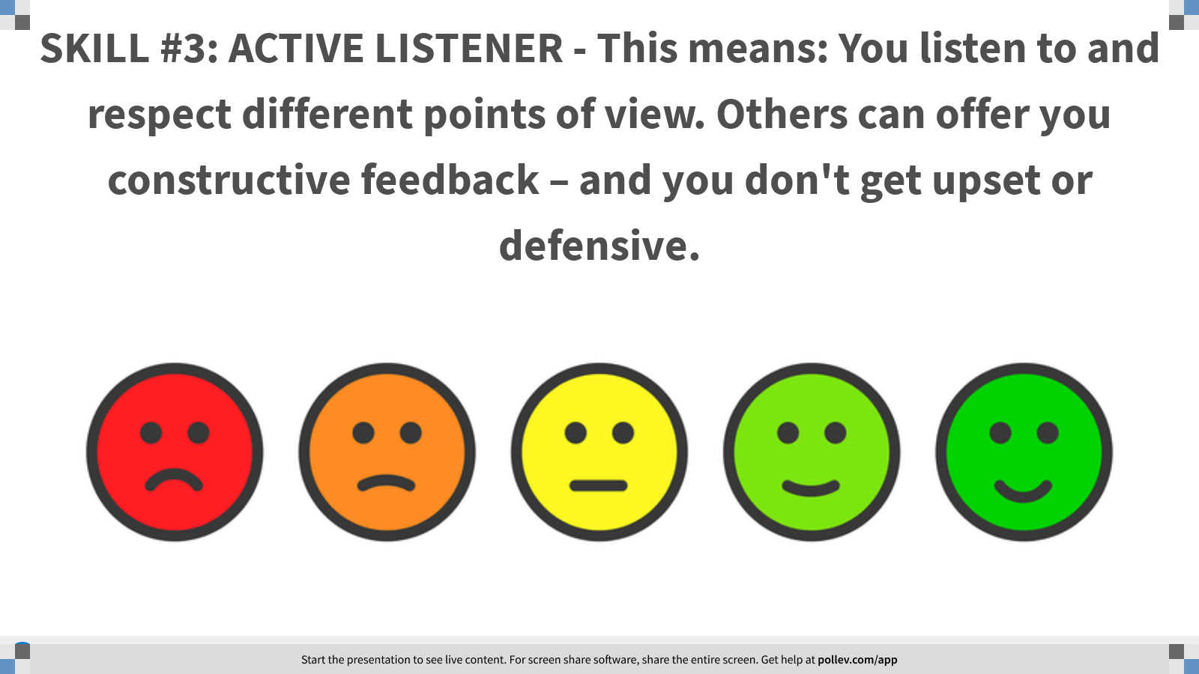
Notes:
Poll Title: SKILL #3: ACTIVE LISTENER - This means: You listen to and respect different points of view. Others can offer you constructive feedback – and you don't get upset or defensive.
https://www.polleverywhere.com/clickable_images/X2vf7F9WUjk6NUFI8AWAg

Slide 89
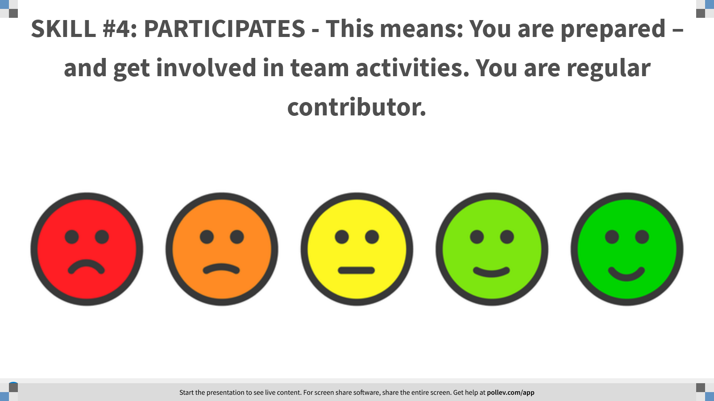
Notes:
Poll Title: SKILL #4: PARTICIPATES - This means: You are prepared – and get involved in team activities. You are regular contributor.
https://www.polleverywhere.com/clickable_images/n4l64KrPutoh1E6Z7ZTNp

Slide 90
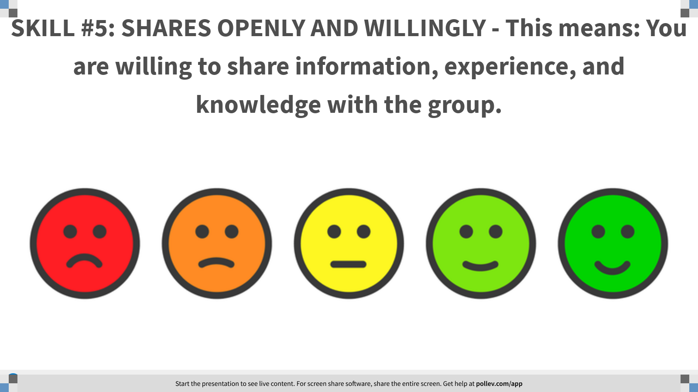
Notes:
Poll Title: SKILL #5: SHARES OPENLY AND WILLINGLY - This means: You are willing to share information, experience, and knowledge with the group.
https://www.polleverywhere.com/clickable_images/HDB8aZ6XLGYpev3pO8boc

Slide 91
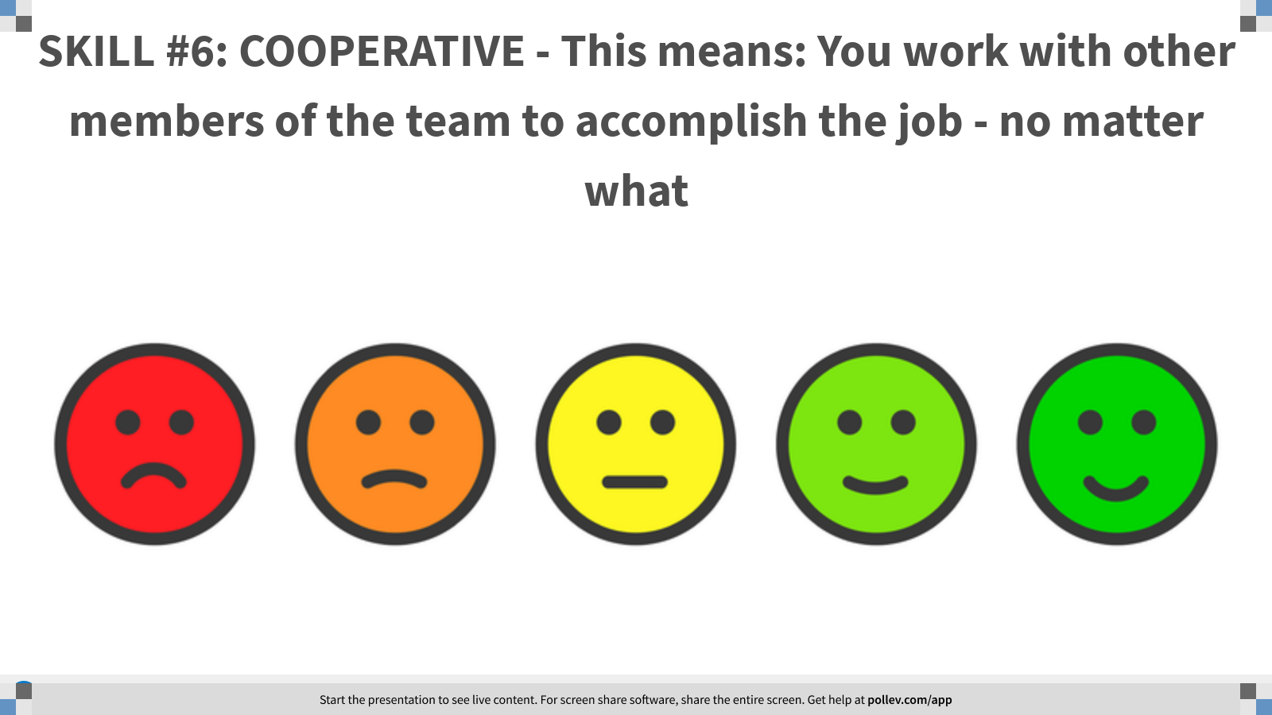
Notes:
Poll Title: SKILL #6: COOPERATIVE - This means: You work with other members of the team to accomplish the job - no matter what
https://www.polleverywhere.com/clickable_images/vsN80XvSsXYzHU8v5zfyx

Slide 92
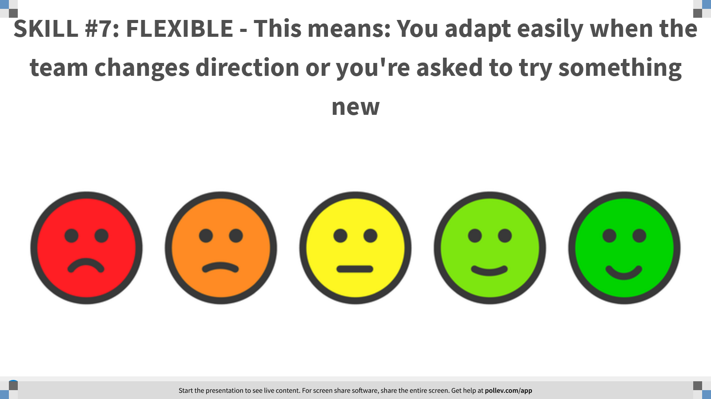
Notes:
Poll Title: SKILL #7: FLEXIBLE - This means: You adapt easily when the team changes direction or you're asked to try something new
https://www.polleverywhere.com/clickable_images/ML9TMazxzwBzIEQUoUy5w

Slide 93
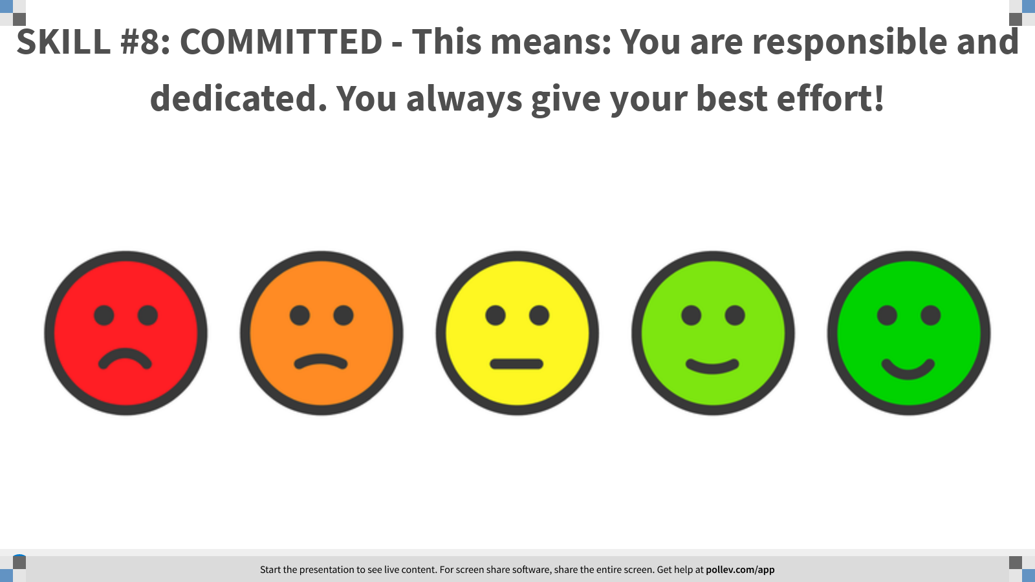
Notes:
Poll Title: SKILL #8: COMMITTED - This means: You are responsible and dedicated. You always give your best effort!
https://www.polleverywhere.com/clickable_images/IypoASHqvTBXSRjotE01k

Slide 94
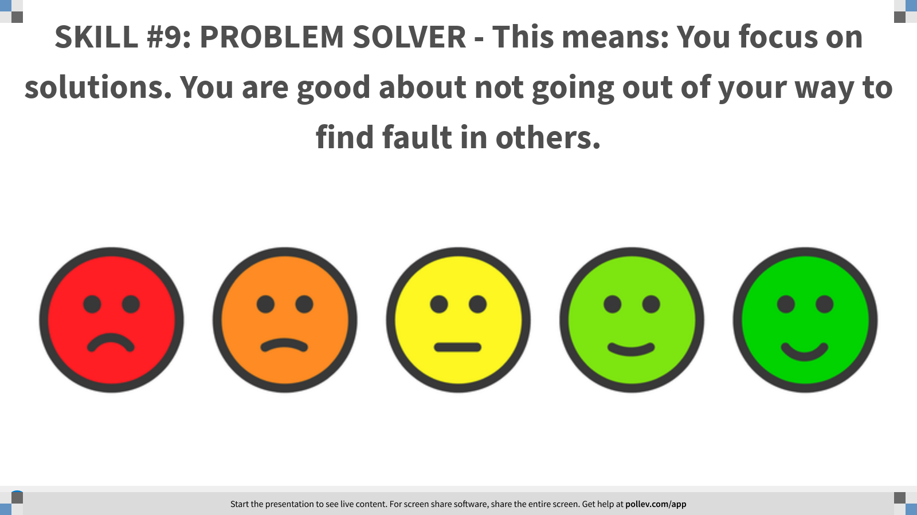
Notes:
Poll Title: SKILL #9: PROBLEM SOLVER - This means: You focus on solutions. You are good about not going out of your way to find fault in others.
https://www.polleverywhere.com/clickable_images/HFFjetNcBThB3JPMLGTcG

Slide 95
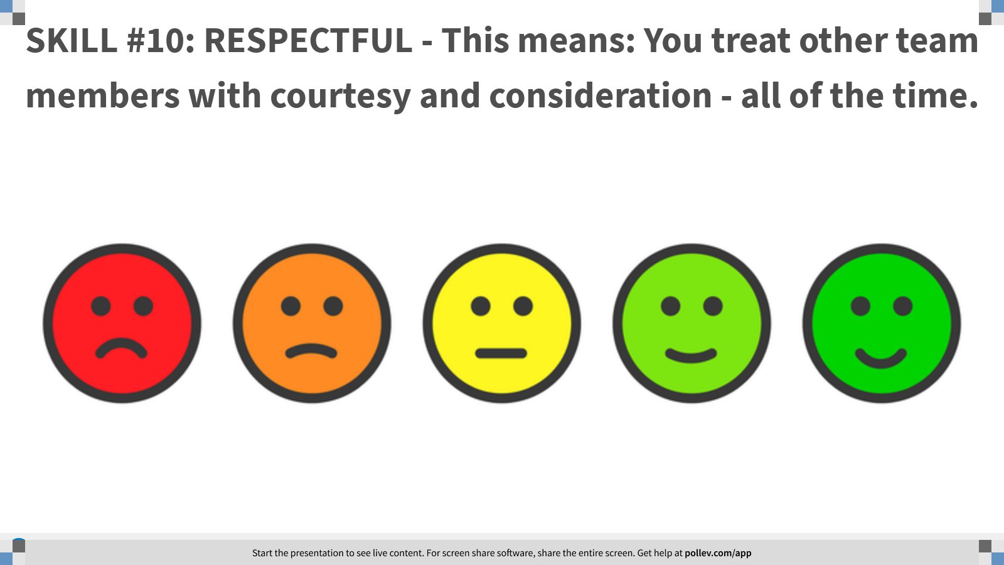
Notes:
Poll Title: SKILL #10: RESPECTFUL - This means: You treat other team members with courtesy and consideration - all of the time.
https://www.polleverywhere.com/clickable_images/KMv1ISAEkd4vGVzwzyjZO

Slide 96
Problem Solving & Critical Thinking
If black boxes survive air crashes, why don’t they make the whole plane out of that stuff?
George Carlin

Slide 97
Everyone experiences problems from time to time. Some of our problems are big and complicated, while others may be more easily solved. There is no shortage of challenges and issues that can arise on the job. Whether in an office or on a construction site, experiencing difficulties with the tasks at hand or with coworkers, the workplace presents ongoing challenges on a daily basis. Whether these problems are large or small, they need to be dealt with constructively and fairly. Having the necessary skills to identify solutions to problems is one of the skills that employers look for in employees.
Problem solving and critical thinking refers to the ability to use knowledge, facts, and data to effectively solve problems. This doesn’t mean you need to have an immediate answer, it means you have to be able to think on your feet, assess problems and find solutions. The ability to develop a well thought out solution within a reasonable time frame, however, is a skill that employers value greatly.⁵

Slide 98
Perception Vs. Reality
What would you do?
The shop owner is talking to another employee as you walk into work. You have reason to believe they are talking about you. This makes you feel uncomfortable and upset.
Raise your Zoom “hand” and I will call on a few participants.

Slide 99
Professionalism
Professionalism:
It’s not the job you do; It’s how you do the job
Author Unknown

Slide 100
Throughout our working lives, most of us will have many different jobs, each requiring a different level or set of skills. No matter the industry – from customer service to an office job to construction and the trades – all of these jobs have one thing in common: in order to succeed and move ahead, you need to demonstrate professionalism. Professionalism does not mean wearing a suit or carrying a briefcase; rather, it means conducting oneself with responsibility, integrity, accountability, and excellence. It means communicating effectively and appropriately and always finding a way to be productive.

Slide 101
Professionalism Survey
What would you do?
Determine which of your skills are “on target” and which might need some improvement by choosing “Always,” “Sometimes,” or “Never.”

Slide 102
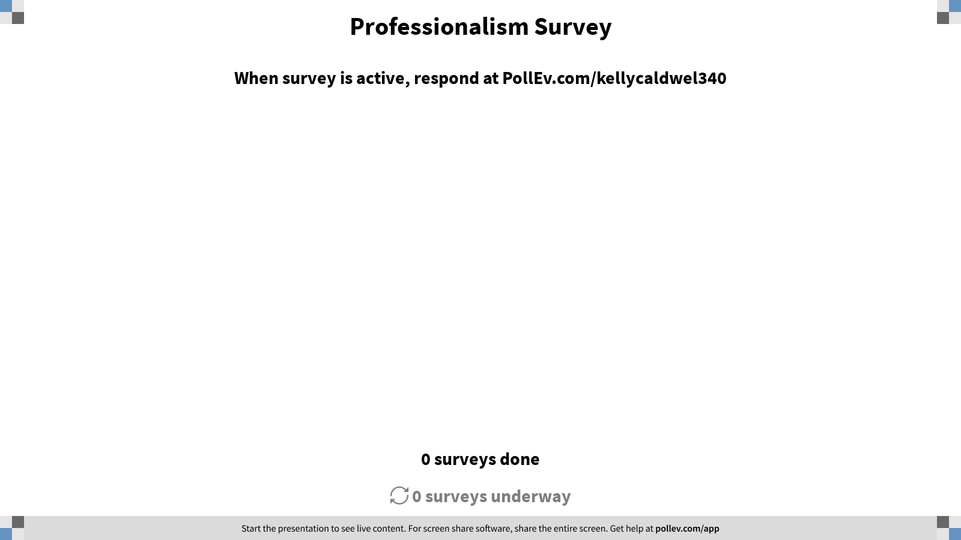
Notes:
Poll Title: Professionalism Survey
https://www.polleverywhere.com/surveys/i8DkdSXVwUi2F7THhs592

Slide 103

Employment Today

Slide 104
COVID-19 State of Employability
While much is uncertain as to what the economy and job market will look like in three to six months, let alone a year, there are several likely consequences, especially for current graduates and job seekers:
Apart from grocery stores and online sellers, the job market has crashed and will not revive for some time.
Competition for available jobs will be greater with applicants needing to distinguish their skill sets beyond academic capacity.
Internships, often a key to employment, have been stopped this term and may well be eliminated for the fall term.
Practica, co-ops, and field placements have been stopped and may not be available for some time.
Interviewing will be virtual and will require a different way of presenting oneself than in person.
Degrees will be less important than demonstrable skills, including such “soft skills” as adaptability, resilience, teamwork, and the ability to communicate effectively in virtual, as well as physical, environments.⁶

Slide 105
Before you go…
Thank you for attending today!

Slide 106
Sources
https://www.shrm.org/resourcesandtools/hr-topics/employee-relations/pages/employers-say-students-arent-learning-soft-skills-in-college.aspx
https://en.wikipedia.org/wiki/Soft_skills
https://www.google.com/search?q=google+translator&rlz=1C1GCEU_enUS887US887&oq=google+translator&aqs=chrome..69i57j0l6j69i64.3112j0j7&sourceid=chrome&ie=UTF-8
https://en.wikipedia.org/wiki/Greek_to_me#:~:text=That's%20Greek%20to%20me%20or,considered%20an%20insult%20to%20some.
https://www.dol.gov/odep/topics/youth/softskills/softskills.pdf
https://www.realcleareducation.com/articles/2020/04/17/employability_in_a_post-covid-19_world__110409.html

